Slide 1
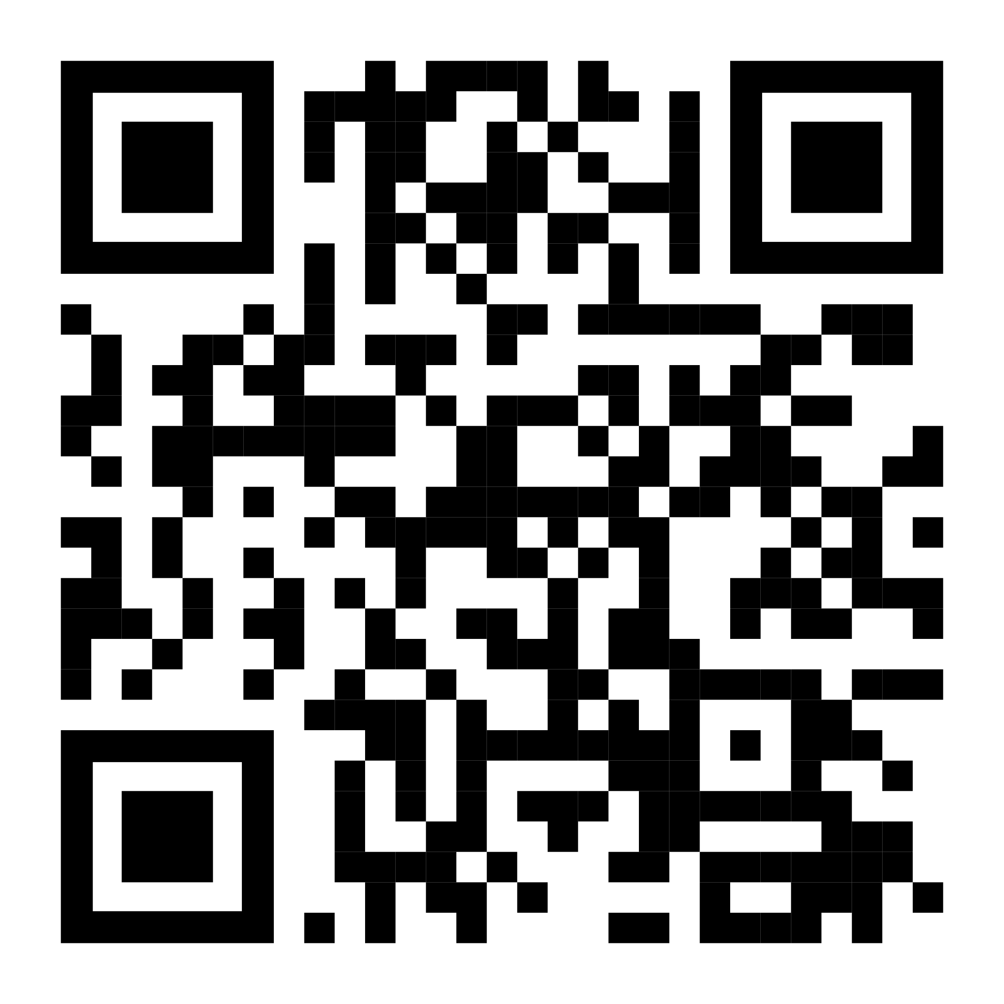
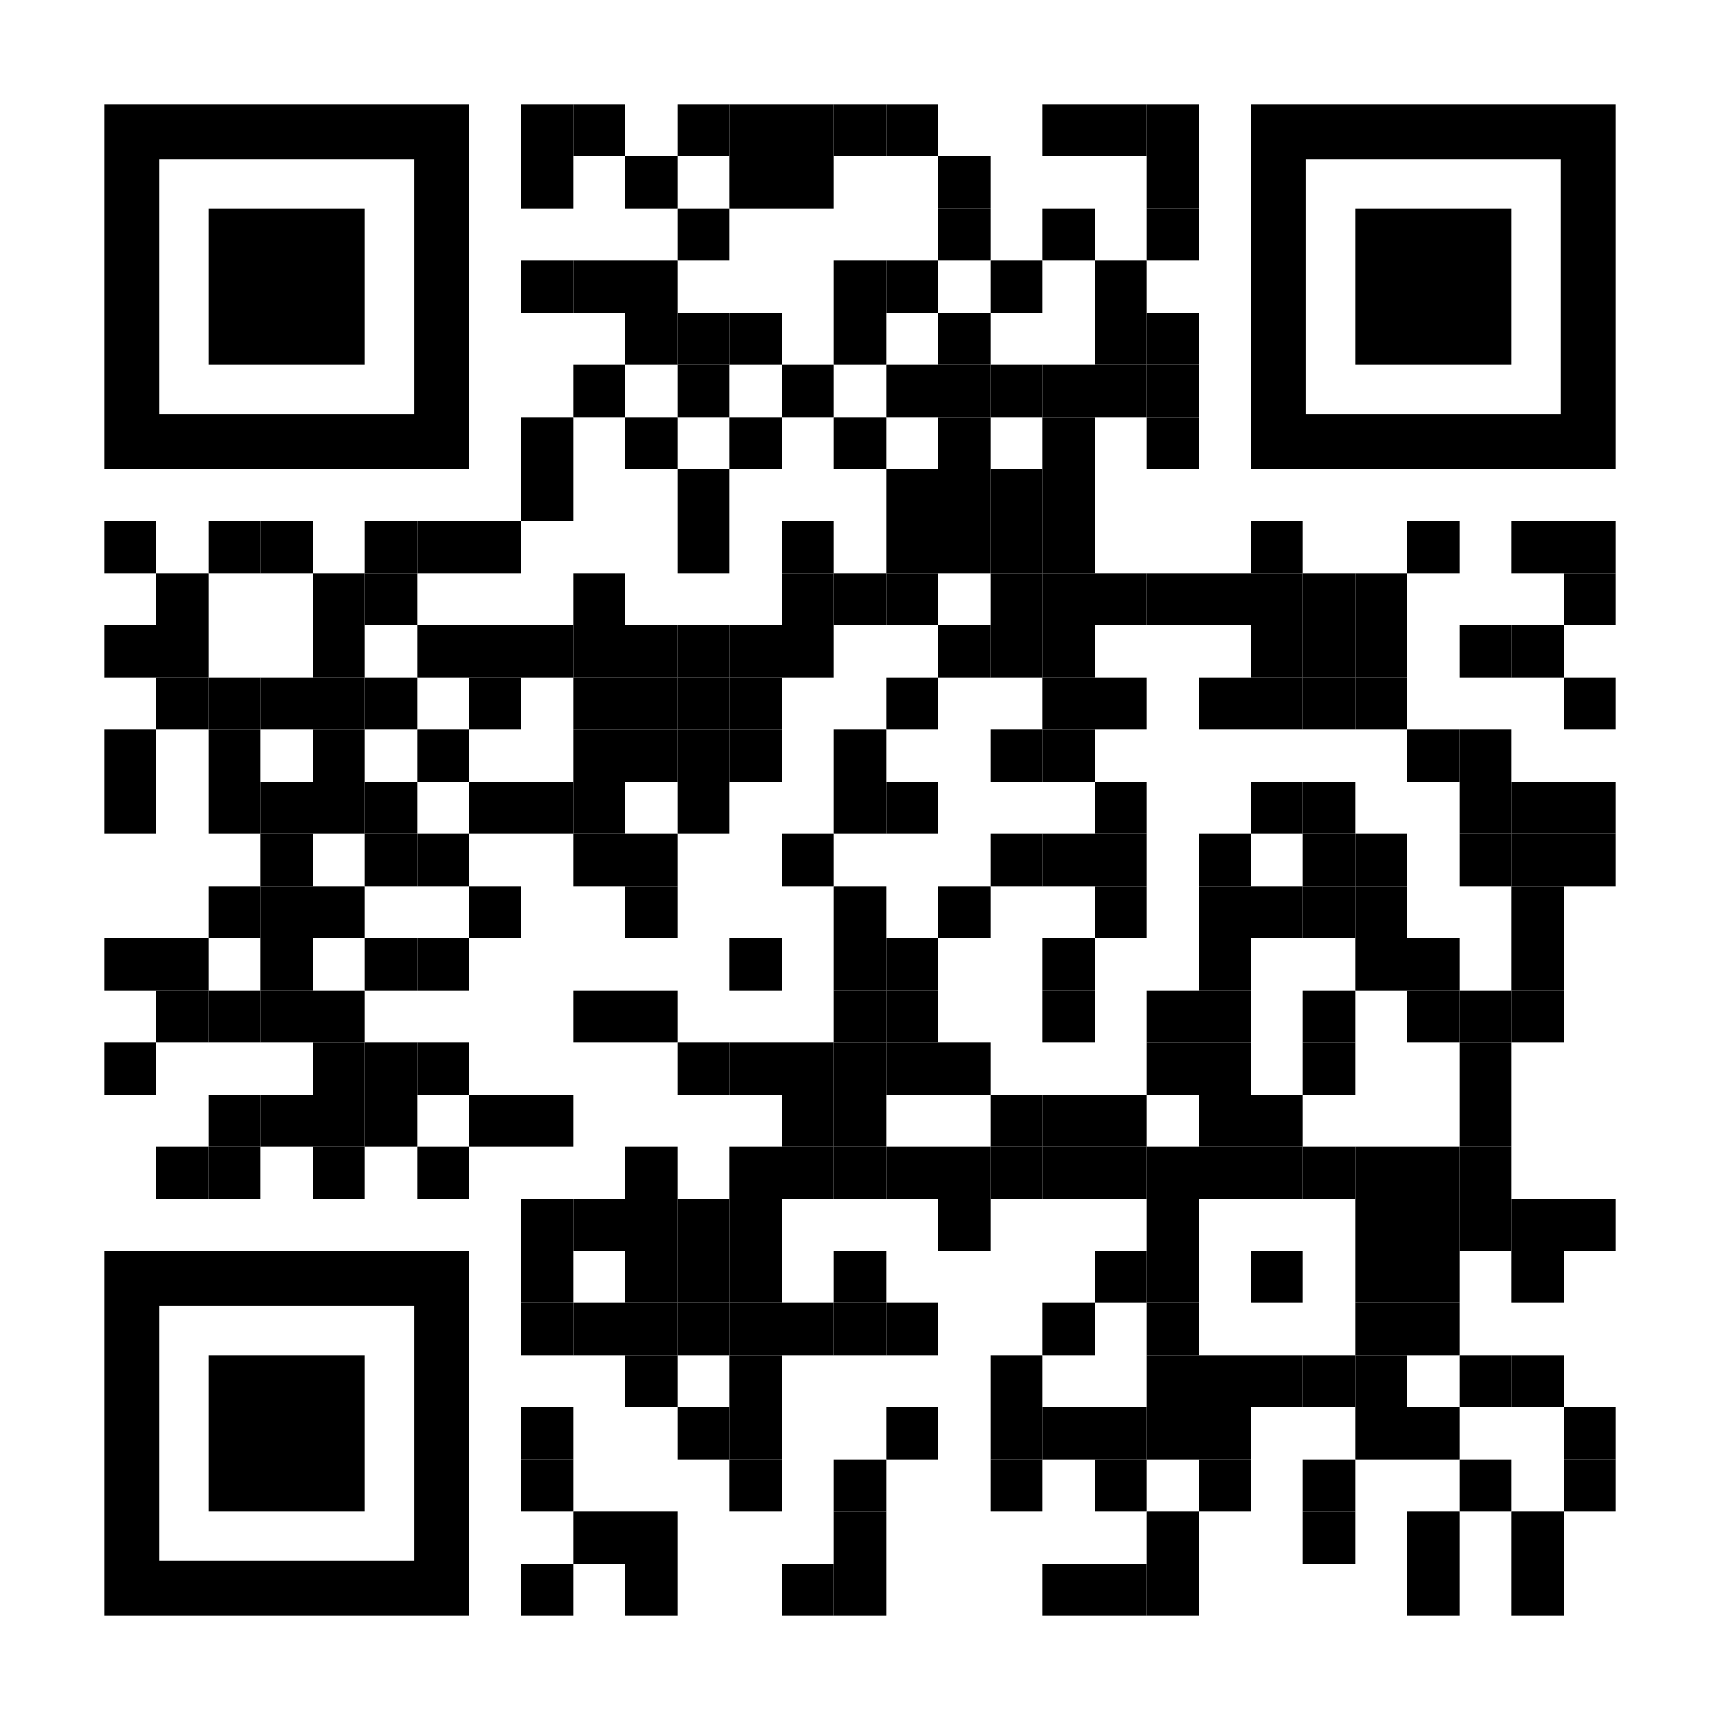
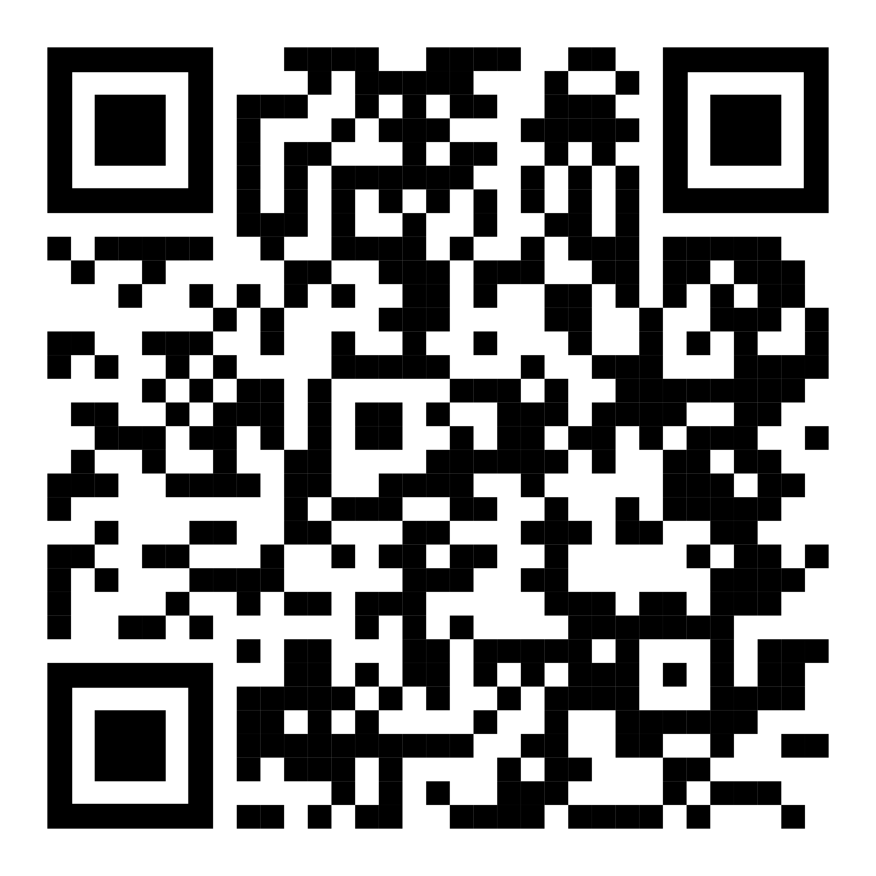
Connect With Us
Join us on your favourite platform of choice to get updates on sessions, and give us feedback and suggestions (we love hearing from you!)
Discord: https://discord.gg/5Yesf2BrbQ
Instagram: https://www.instagram.com/ussc.io
Whatsapp: https://chat.whatsapp.com/CeAfqpJUujo6IZIoJ8iMbG

Slide 2
“Committing” to Git — Workshop
University of Stirling Society of Computing
CC By SA 4.0

Slide 3
What is Git
Git is a version control system
Git is distributed
Git is everywhere!

Slide 4
Git is a Version Control System
A Version Control System (VCS) is a very wise thing to use. It allows you to:
Revert selected files back to a previous state
Revert the entire project back to a previous state
Compare changes over time
See who last modified something that might be causing a problem (who introduced an issue and when)
Easily collaborate on projects with others
With a VCS, If you screw things up or lose files, you can easily recover, and you can merge the work of several people together automatically.

Slide 5
Git is Distributed
Git lets you pull changes from, and push changes to, remote copies of your project repository
Each copy stores the entire project history (every version of every file)
Hosted code-forges like Github, Gitlab, and Sourcehut provide a central place from which to distribute your repository, and accept contributions from others
Example of a distributed VCS

Slide 6
Git is Everywhere!
Git scales, from the smallest of hobby projects, to the Linux kernel, one of the largest free software projects in the world, and the project git was created for
Millions of developers, acting individually or working for thousands of companies, use git every day
It has become the de facto standard version control system for much of the industry
Google
Microsoft
Twitter
LinkedIn
Netflix
Perl
PostgreSQL
Android
Linux
Ruby on Rails
QT
Gnome
Eclipse
KDE
X

Slide 7
Installing Git
Refer to https://lowerelements.club/ussc-git for installation instructions
If you’d like a graphical way to use git, install Github Desktop from https://desktop.github.com
You should also explore you’re IDEs support for git (either built in or via a plugin) after this session
The Installing Git section of the git book may also be useful

Slide 8
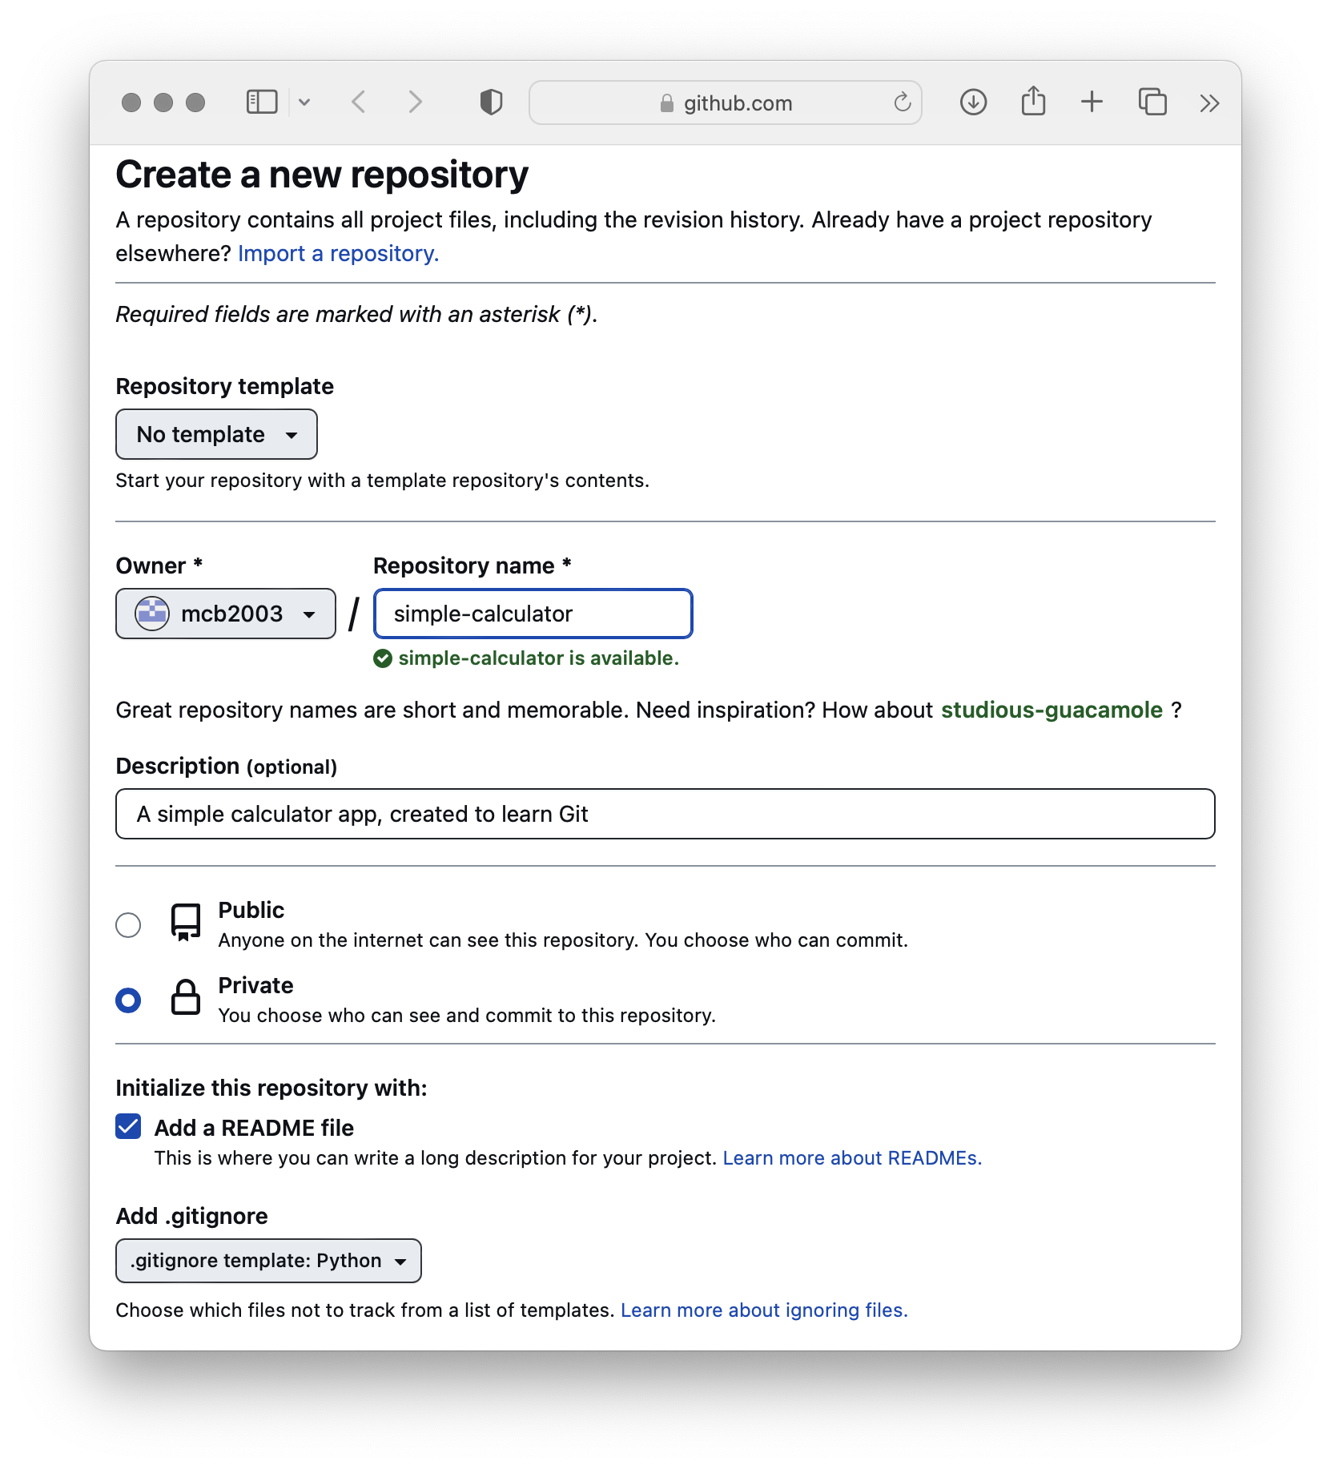
Create a Repository
Sign in or create an account on GitHub.com
Click the “Create New” button, choose “New Repository”
Give your repository a name, description, and tick the box to add a README
Keep your repository private for now, unless you want it to be public
Select a gitignore for the language you intend to use if one exists (this prevents git from saving various temporary files and build artefacts generated by your language of choice
If you’re repo will be public, choose a license for your code

Slide 9
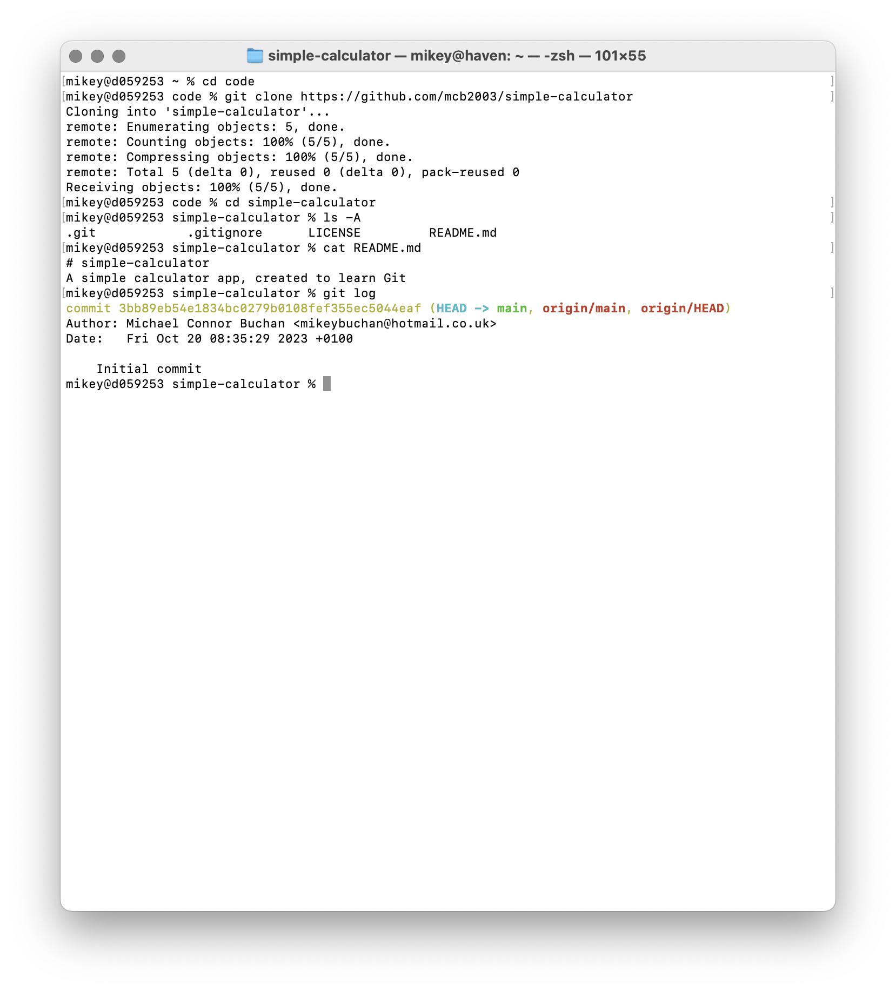
Clone the Repo Locally
Open a Git Bash (Windows), or a Terminal (macOS & Linux)
Change directory to the location you’d like your repository to be stored
Issue the “git clone” command, passing the URL of the Github repository
Once the repo has been cloned, change directory into its working directory
You’ll see a .git directory in the working directory (this is the database git keeps of every version of every tracked file, plus metadata)
Depending on what options you chose when creating the repo, you may also see README.md, LICENSE and / or .gitignore (Github has created an initial commit for you with these files)
Tip: You can create a repo locally, without using Github, by running “git init name”, where name is the name of the directory you want to create

Slide 10
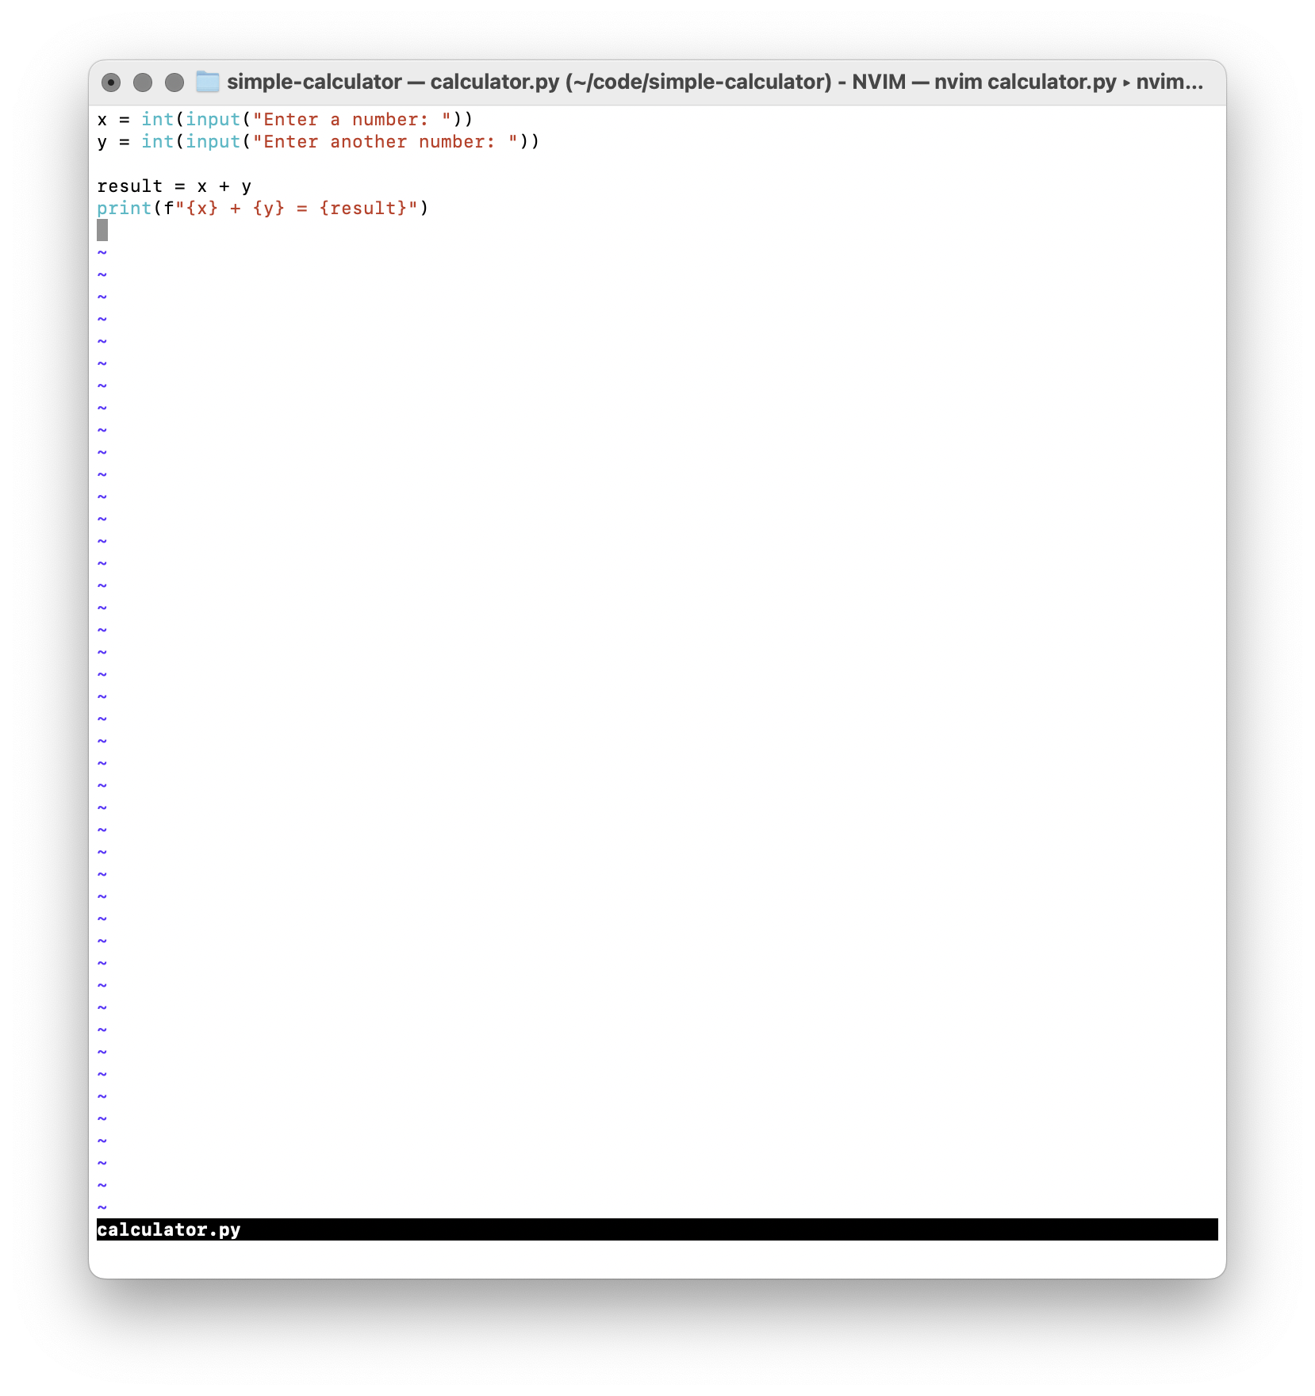
Write your Initial Code
Start by making a simple program that asks for two integers, adds them, and prints the result
Feel free to use whatever language you want, and don’t forget to test your code

Slide 11
The Git Workflow
Git stores your project’s history as a series of commits. Each commit represents a snapshot of what every file in your repository looks like in that particular revision.
Git has three main states that your files can reside in: modified, staged, and committed:
Modified means that you have changed the file but have not committed it to your database yet.
Staged means that you have marked a modified file in its current version to go into your next commit snapshot.
Committed means that the data is safely stored in your local database.
When working with Git, you start by checking out the project from the repository into your working directory. You then make changes to files in your working directory, stage those changes in the staging area, and finally commit those changes to the repository.
The working directory is where you make changes to files in your project. The staging area is where you prepare changes for committing to the repository. The repository is where all of your project’s history is stored.

Slide 12
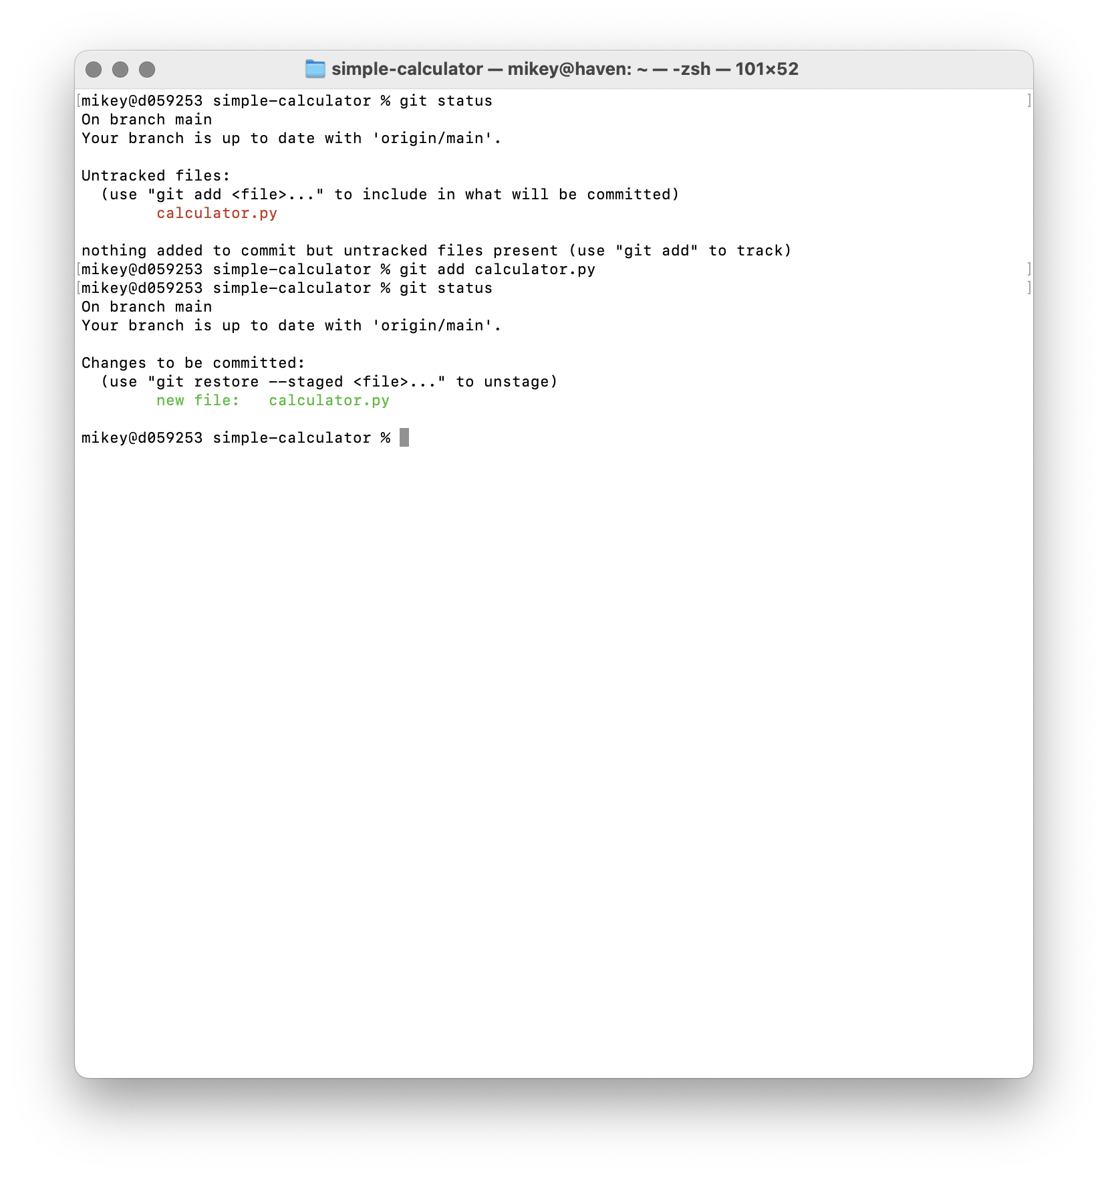
Stage Your Changes
Now that we’ve made changes to files in our working directory (in this case by adding a new file), we must stage them
This is done with the “git add” command, passing the list of files to stage
Tip: You can run “git status” at any time to get an overview of your working directory and staging area (I do this so often that I have aliased the command “gist” to “git status” so I can type it quickly)

Slide 13
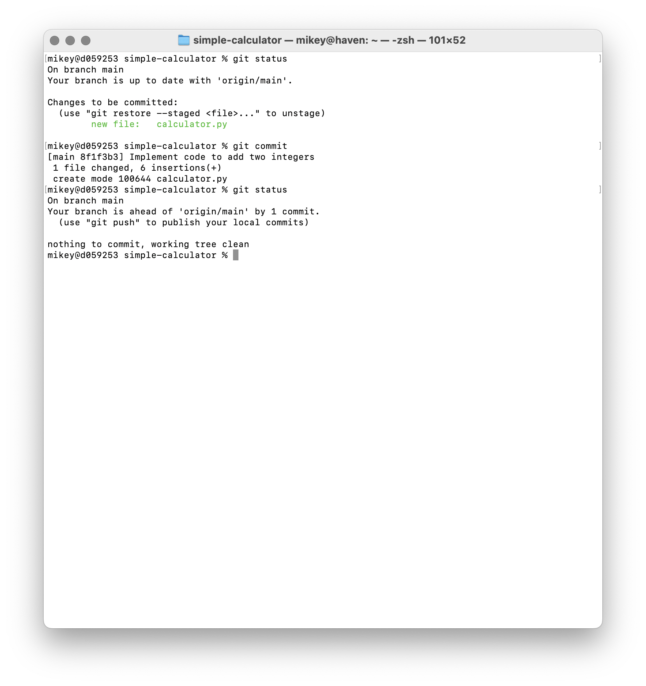
Commit Your Changes
We’re ready to write our first commit!
Unsurprisingly, this is done with the “git commit” command
Typing “git commit” will open an editor for you to write a commit message. You can also run “git commit -m”, passing a message in quotes
Commit messages are free-form plain text, used to explain what the changes in this commit achieve.
Good commit messages are as important as good code comments, especially in projects worked on by more than one person.
The first line is a short summary, which should be less than 50 characters
The summary should complete this sentence: when applied, this commit will… “Fix text rendering in CJK languages”. “Add support for protocol v3”. “Refactor CRTC handling”
After a blank line, you may describe what the changes achieve in greater detail in the message body
See also Tips for a Disciplined Git Workflow (from which I stole those examples)
Save and close your editor, and the commit will be made

Slide 14
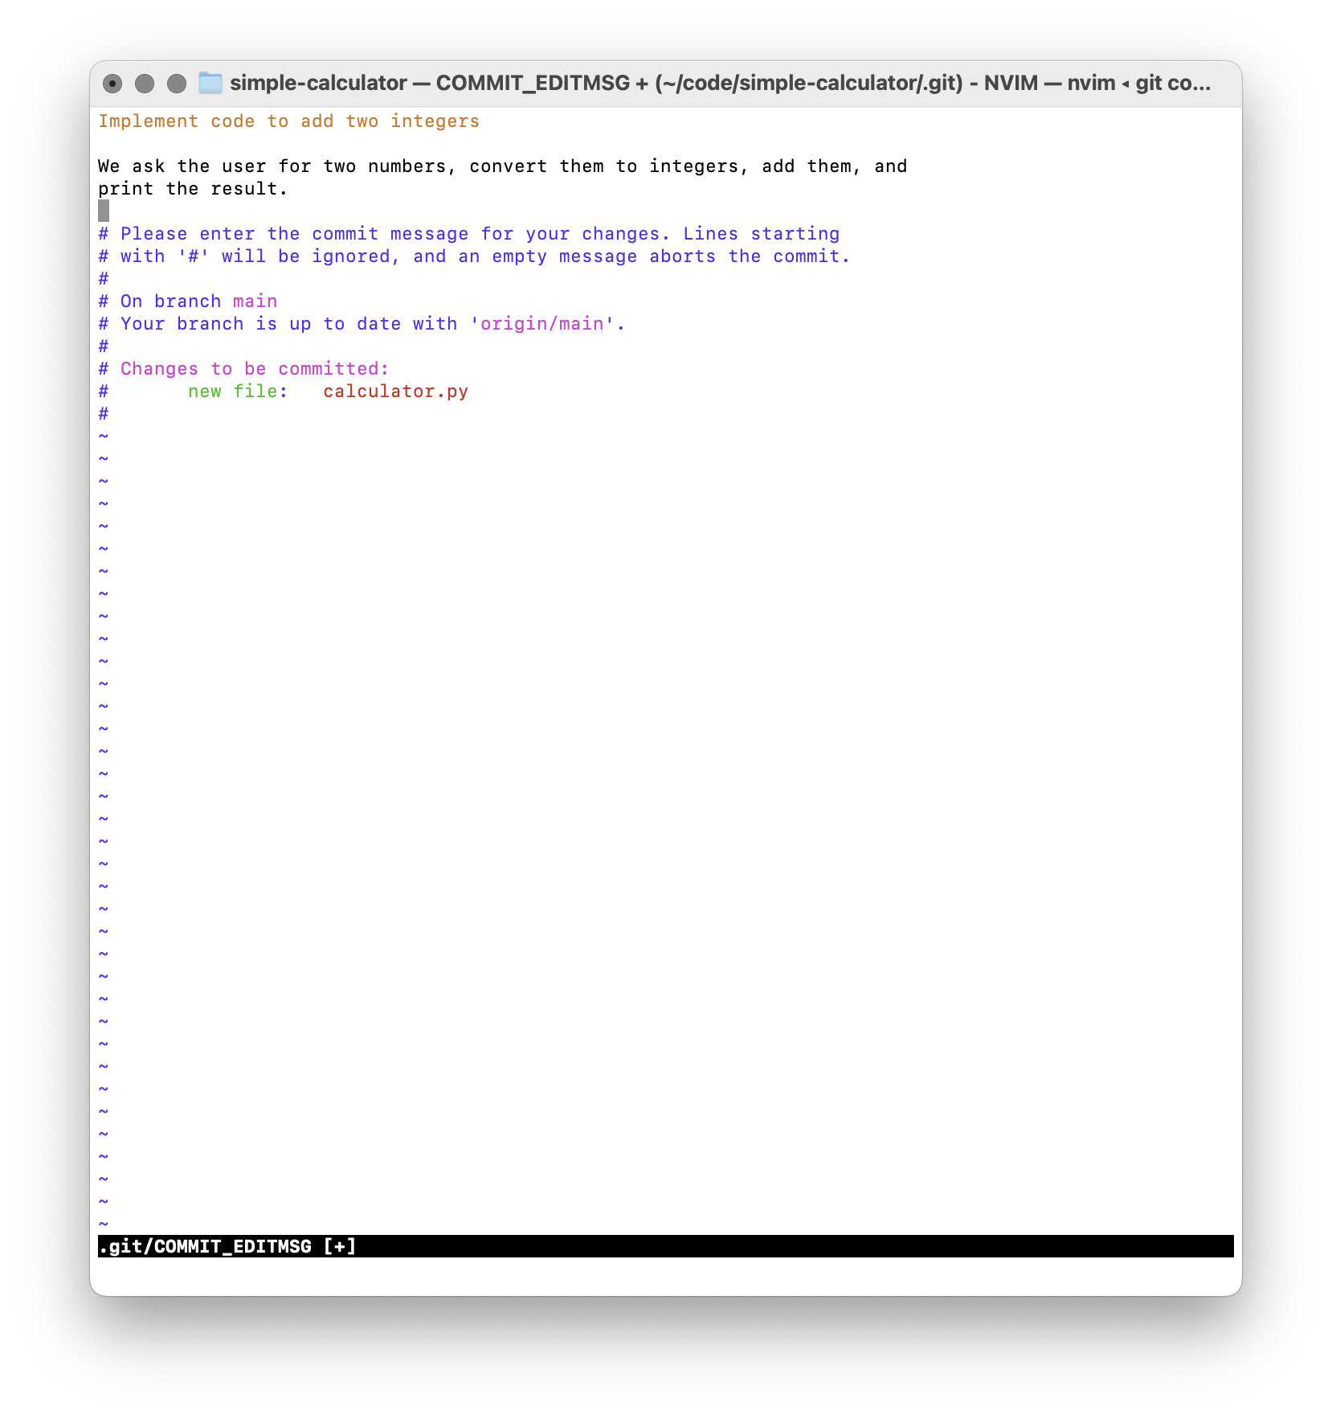
Commit Your Changes
We’re ready to write our first commit!
Unsurprisingly, this is done with the “git commit” command
Typing “git commit” will open an editor for you to write a commit message. You can also run “git commit -m”, passing a message in quotes
Commit messages are free-form plain text, used to explain what the changes in this commit achieve.
Good commit messages are as important as good code comments, especially in projects worked on by more than one person.
The first line is a short summary, which should be less than 50 characters
The summary should complete this sentence: when applied, this commit will… “Fix text rendering in CJK languages”. “Add support for protocol v3”. “Refactor CRTC handling”
After a blank line, you may describe what the changes achieve in greater detail in the message body
See also Tips for a Disciplined Git Workflow (from which I stole those examples)
Save and close your editor, and the commit will be made

Slide 15
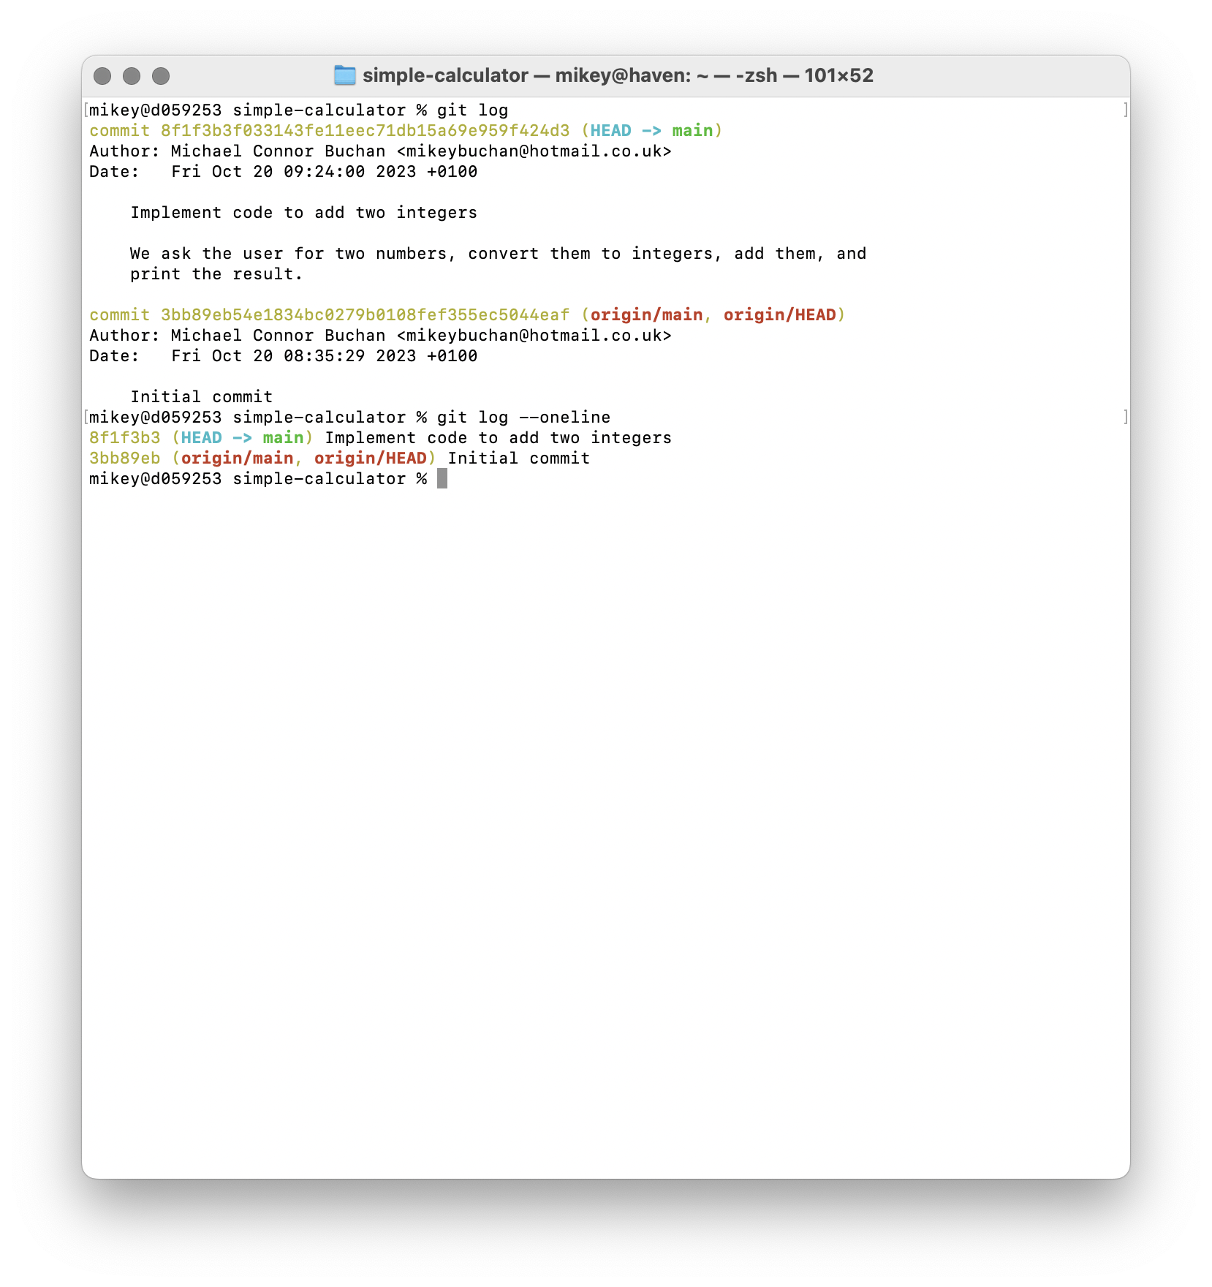
Viewing the History
Use the “git log” command to view a project’s history
“Git log” will open a pager program if the log is long enough that it will scroll, Exit this by pressing “q”
Each commit is composed of:
A SHA1 commit hash, which uniquely identifies this commit
The author’s name and email address
The date the commit was made
The commit message
The updated files (though these aren’t shown in the log by default)
Tip: “git log” has many options for customising what you see:
“Git log —oneline" One commit per line
“Git log —stat” Show which files were changed
“Git log —summary” show only the summary line of each message
“Git log -5” show the latest 5 commits

Slide 16
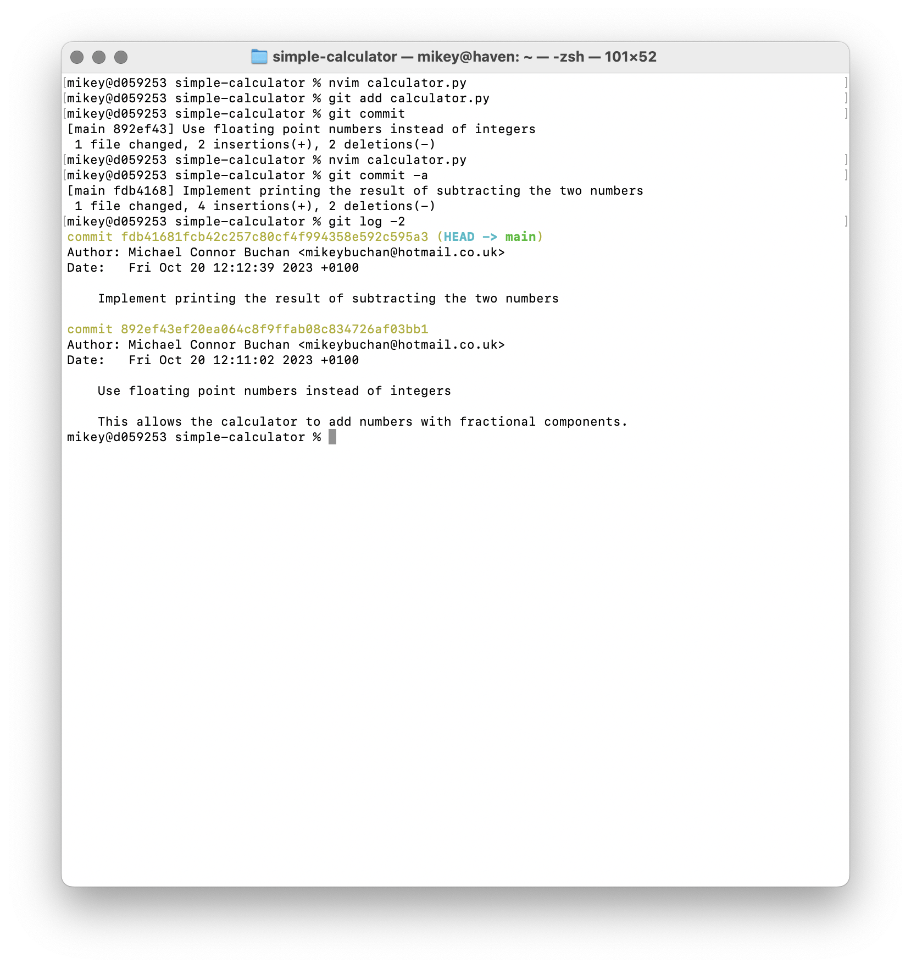
Let’s Improve Our Code
Modify your code to handle floating point numbers instead of integers
Stage and commit these changes, writing a suitable commit message
Next, make your program also output the two numbers subtracted from each other
This time, instead of staging and committing separately, run “git commit -a”
This automatically stages all changes you’ve made in tracked files since the last commit, and like usual, opens your editor so you can write a commit message
Tip: as Tips for a Disciplined Git Workflow says: “Each commit should be a self-contained change”
“Avoid sneaking in little unrelated changes into the same commit”
“avoid breaking one change into several commits, unless you can refactor the idea into discrete steps - each of which represents a complete change in its own right”
“If this is true of your repository, then you can check out any commit and expect the code to work correctly”

Slide 17
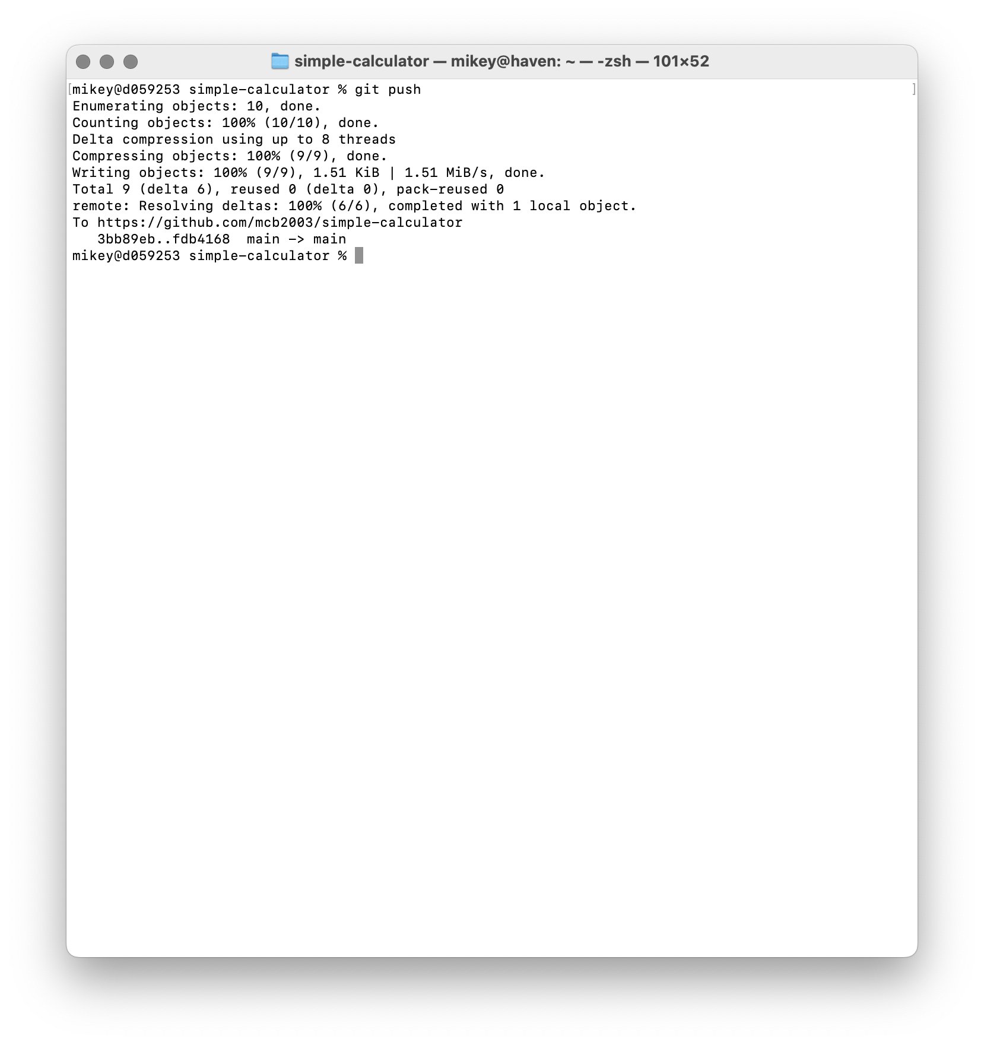
Publishing to Github
So far, the changes we’ve made have only been recorded in our local working copy of the repository
To publish these changes to Github use the “git push” command
You will be asked to authenticate with your Github account if you haven’t used git with it already
Note: git-credential-manager makes this step much easier. If you have issues authenticating, there are other ways to push code to Github, such as setting up a personal access token, or using git over SSH
Once the push is complete, refresh the repo’s Github page, and you should see the changes you made, and be able to view the commit history
Similarly, to pull code from a remote repository into your working copy, use “git pull”

Slide 18
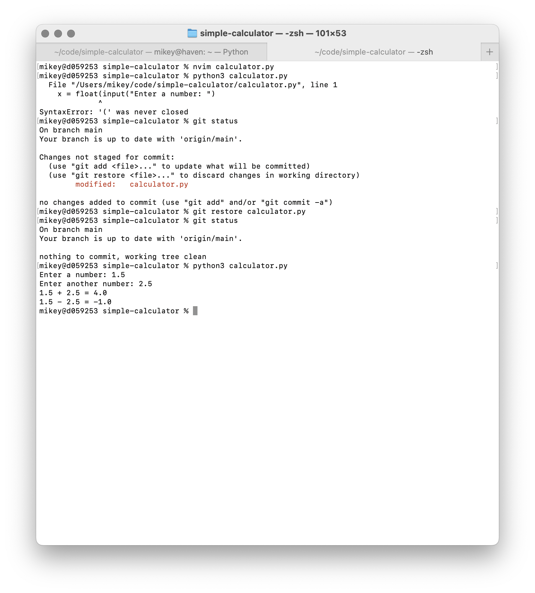
Undoing and Restoring Things: Untracked & Staged
The power of a VCS is that you can go backwards in time to undo something you did wrong, or restore something you accidentally removed
Let’s introduce an error into our code
Whoops, we’d like to revert the changes we made to this file, let’s check “git status”
Git notices the file has been removed, and suggests two possible options: add the modifications to git’s database, or restore the file to your working directory
Running the “git restore file” command, where file is the path to the file you deleted, brings the old version back from git’s database
This will even work if you delete the file completely!
Note: If you’ve already staged your changes, and would like to un-stage them, run “git reset HEAD file”, where file is the path to the file to un-stage
This command is a little strange, and “HEAD” must be written in upper case. This is because “git reset” is a very versatile command that can do a lot more than simply un-staging changes you’ve made to a file or set of files. For more info, see Reset Demystified

Slide 19
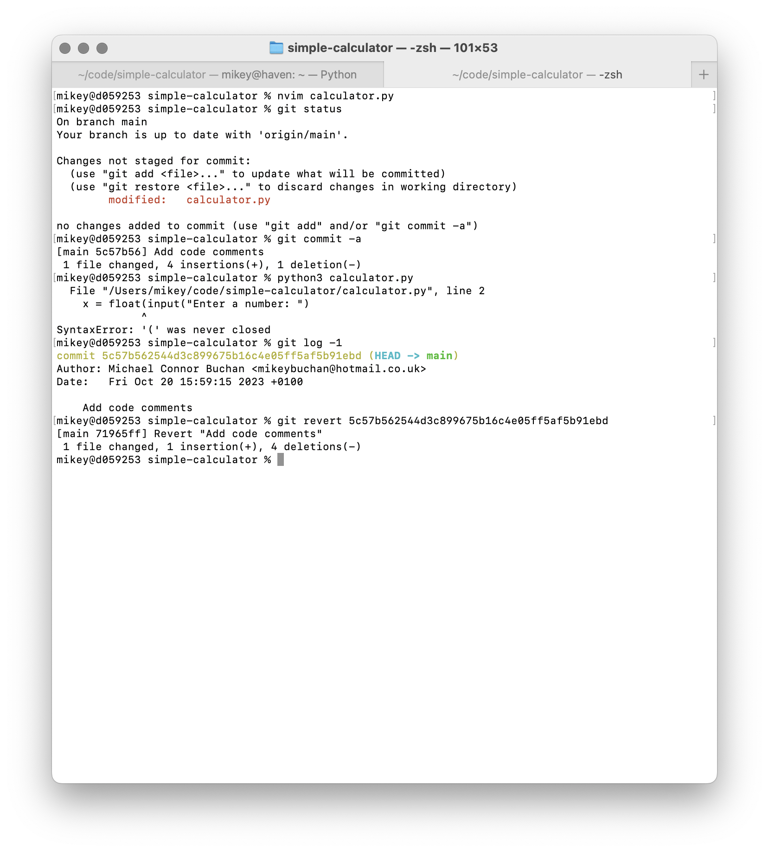
Undoing and Restoring Things: Committed
Now let’s say we make another commit (E.G. adding comments to our code), but we accidentally introduce a syntax error at the same time
Uh oh! No big deal, just run “git log”, find the commit hash, and run “git revert hash”
Your editor will open, and a message explaining that this commit reverts another will be pre-filled. You should add details of why this commit was reverted to the commit body
Close your editor, and a new commit will be made that reverts the old commit
Note: This is far from the only way to revert something you did wrong in a previous commit. For more advanced git users, check out git interactive rebase, which lets you modify commits while keeping your history nice and clean

Slide 20
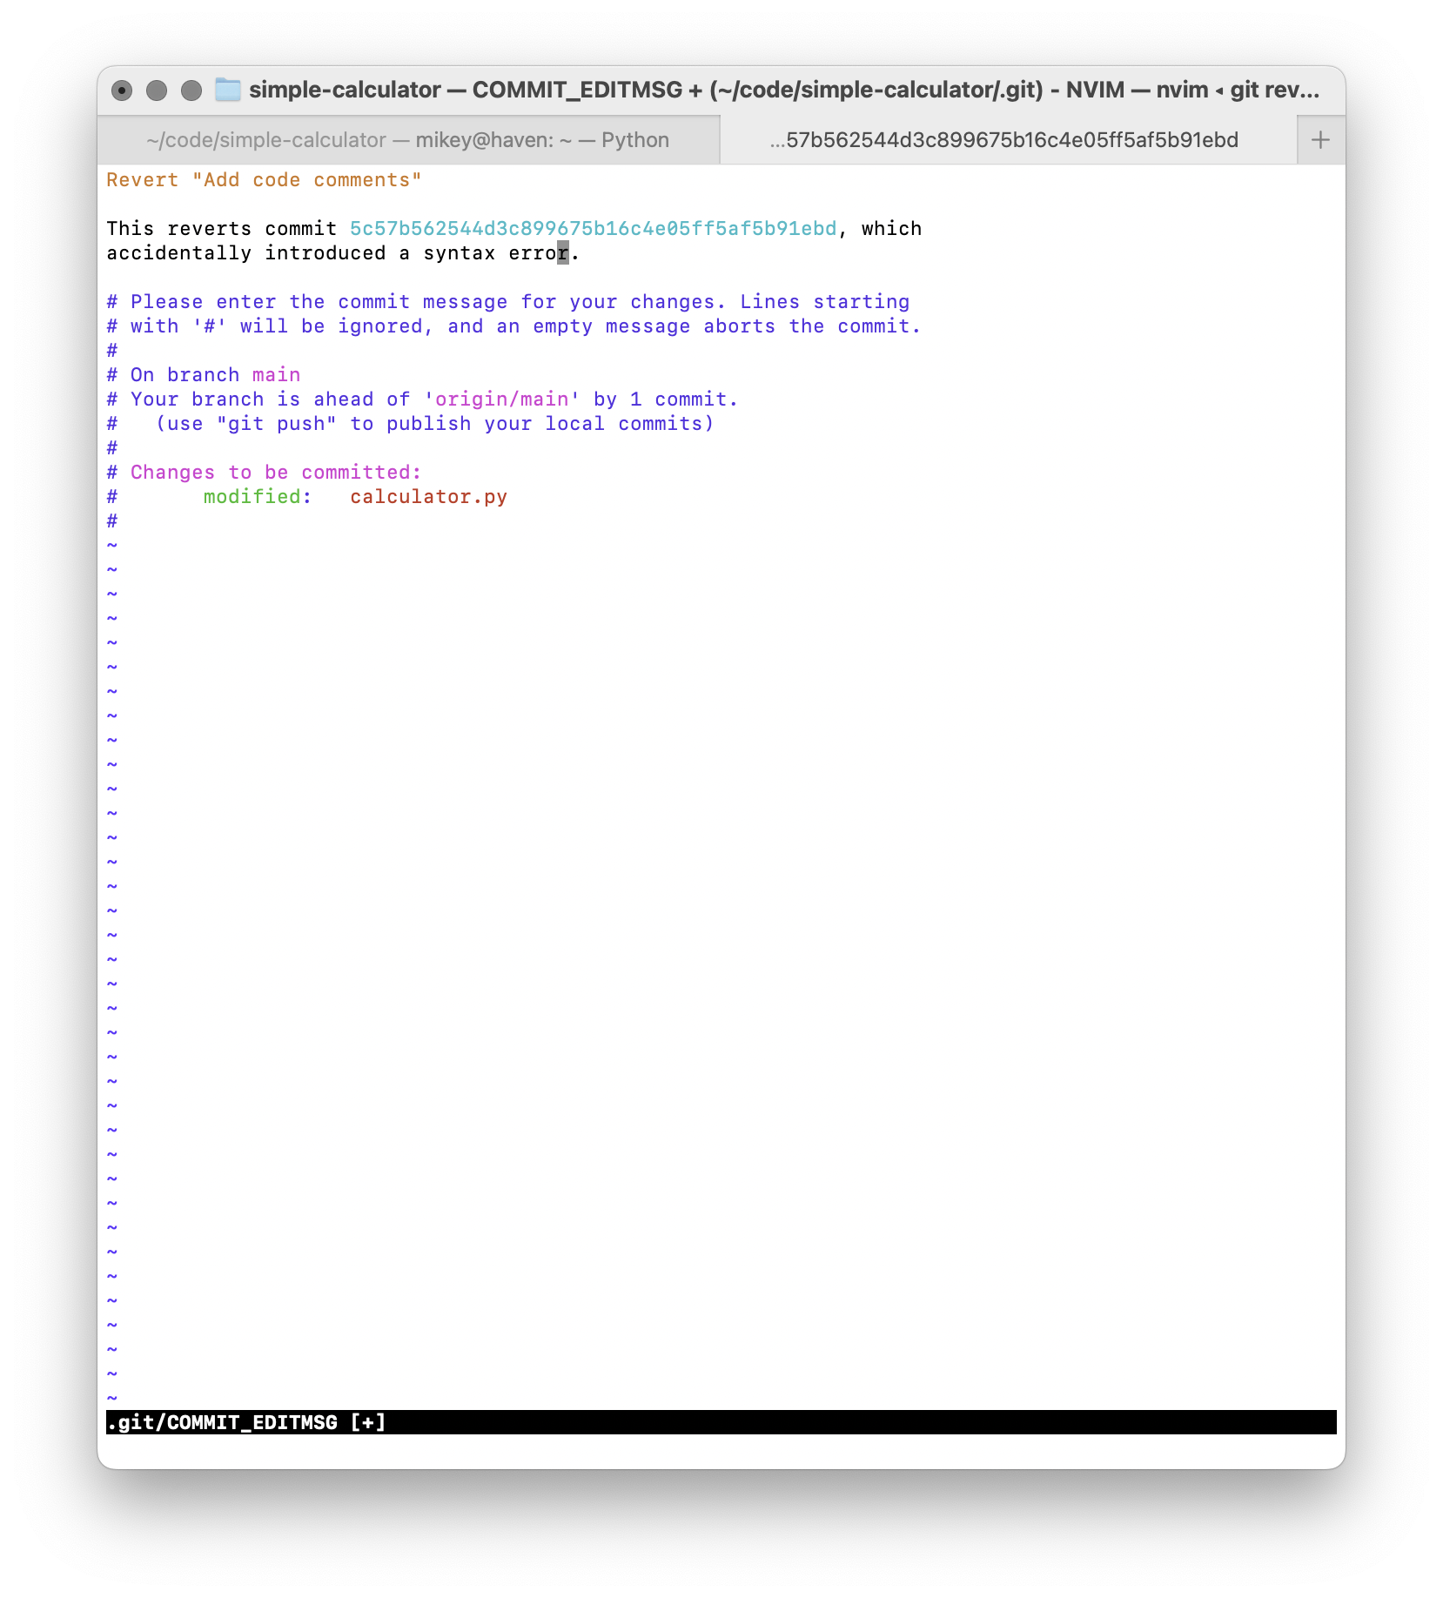
Undoing and Restoring Things: Committed
Now let’s say we make another commit (E.G. adding comments to our code), but we accidentally introduce a syntax error at the same time
Uh oh! No big deal, just run “git log”, find the commit hash, and run “git revert hash”
Your editor will open, and a message explaining that this commit reverts another will be pre-filled. You should add details of why this commit was reverted to the commit body
Close your editor, and a new commit will be made that reverts the old commit
Note: This is far from the only way to revert something you did wrong in a previous commit. For more advanced git users, check out git interactive rebase, which lets you modify commits while keeping your history nice and clean

Slide 21
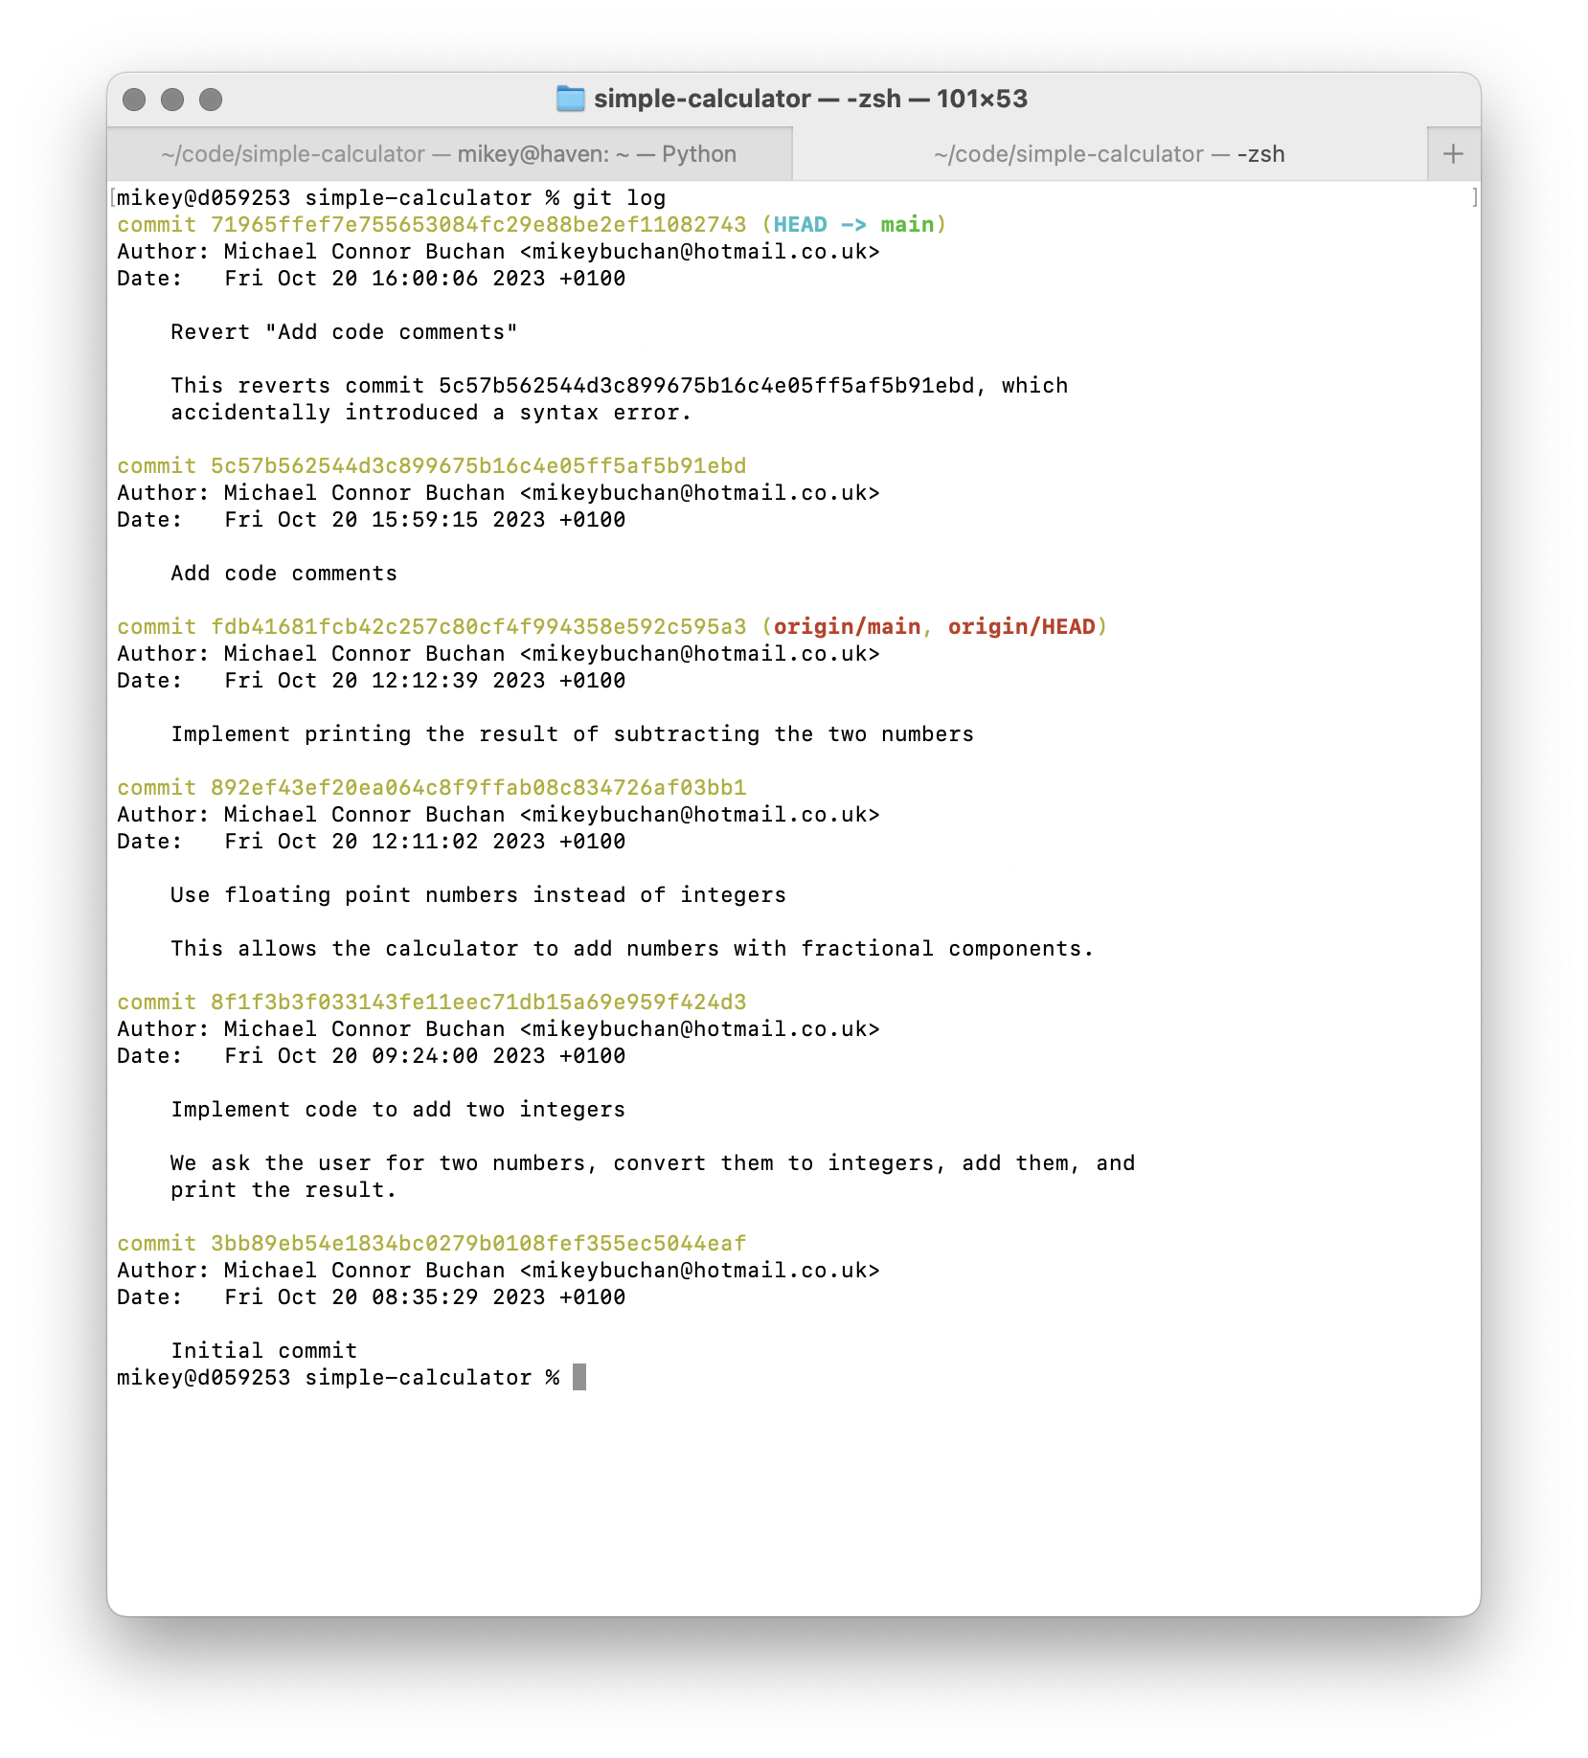
Undoing and Restoring Things: Committed
Now let’s say we make another commit (E.G. adding comments to our code), but we accidentally introduce a syntax error at the same time
Uh oh! No big deal, just run “git log”, find the commit hash, and run “git revert hash”
Your editor will open, and a message explaining that this commit reverts another will be pre-filled. You should add details of why this commit was reverted to the commit body
Close your editor, and a new commit will be made that reverts the old commit
Note: This is far from the only way to revert something you did wrong in a previous commit. For more advanced git users, check out git interactive rebase, which lets you modify commits while keeping your history nice and clean

Slide 22
Parallel Branches of Commits
Git supports lightning fast, light weight branches, which are a great way to work on multiple features of a project at once, while keeping the changes you make for one feature separate from the changes of another
Branches allow you to diverge from the main history of the project, work on something for a while, then merge that work back into the main branch, or any other branch for that matter
Branches are light weight and fast because they don’t make a new copy of all your data, they simply point to your existing commits
Git keeps a special pointer called “HEAD” that points to the branch you’re currently on
When you create a new repository, you start out on the “main” branch
This branch isn’t special in any way, it’s just a regular branch that happens to be the default
Depending on how you create your repository, your default branch might be “master”, or even something else, but it is nevertheless completely normal

Slide 23
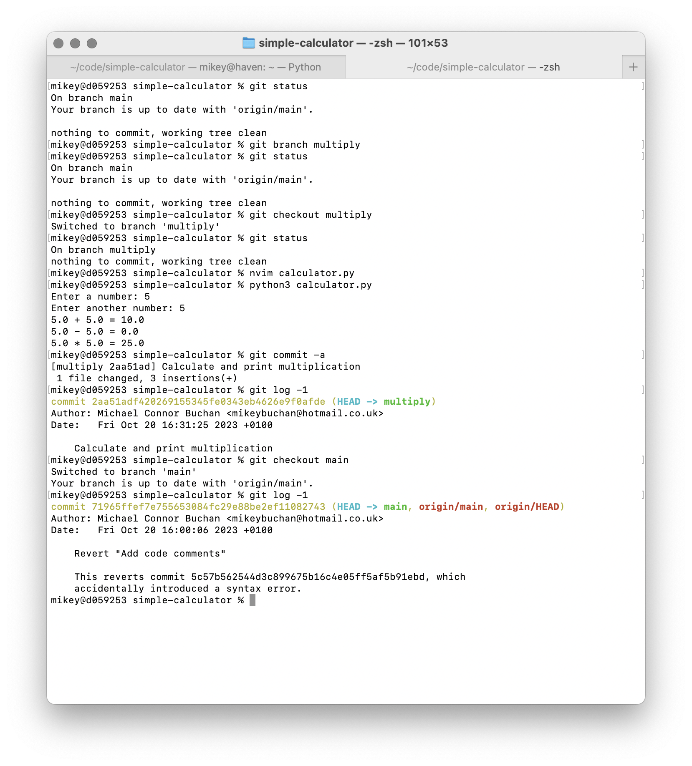
Using Branches
We’re going to add printing the results of multiplying and dividing the two numbers to our calculator, but we’ll add each calculation on a separate branch
Run “git branch multiply” to create our “multiply” branch, then run “git checkout multiply” to switch to it
Tip: This is so common that you can shorten these two commands to just “git checkout -b multiply”
Write, stage and commit your code to multiply the two numbers, and print the results
Switch back to the “main” branch with “git checkout main” You’ll notice your changes are not listed in “git log”, as they aren’t committed to this branch
Repeat these steps for the “divide” branch
Note: Make sure you’re on “main” when you create “divide”, git uses your current branch as the starting point for the new branch
Note: It is frivolous to create separate branches for features that can be added in a single commit like these, but they’re much more useful when you’re working on two or more large features at the same time

Slide 24
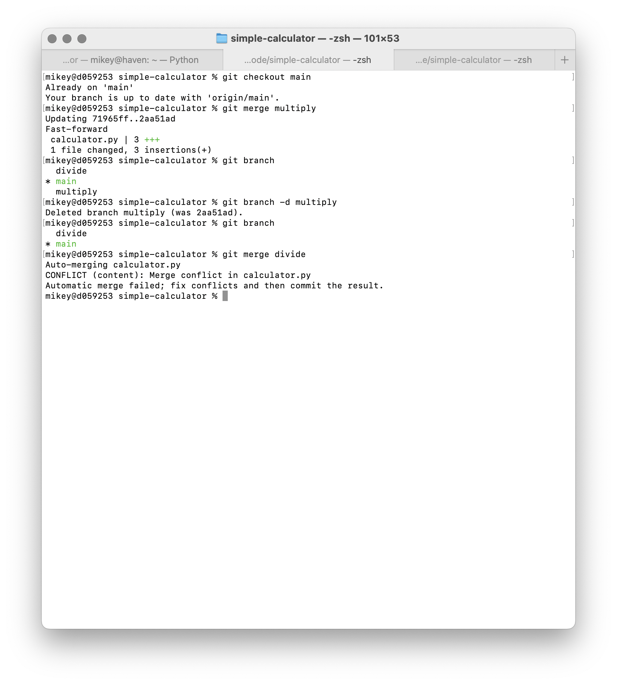
Merging Branches
There will come a point where you’ve finished the work in a branch, and you’d like to collect the work you did in it back into your “main” branch. This is called merging a branch
To merge our two feature branches, first make sure you’re on the main branch with “git checkout main”
Next, simply run “git merge multiply”
Git will take note of what has changed since the two branches last diverged, and fast-forward your “main” branch to include the work you did on “multiply”
We don’t need that “multiply” branch anymore, you can delete it with “git branch -d multiply”
Repeat these steps to merge the divide branch, and … oh no!

Slide 25
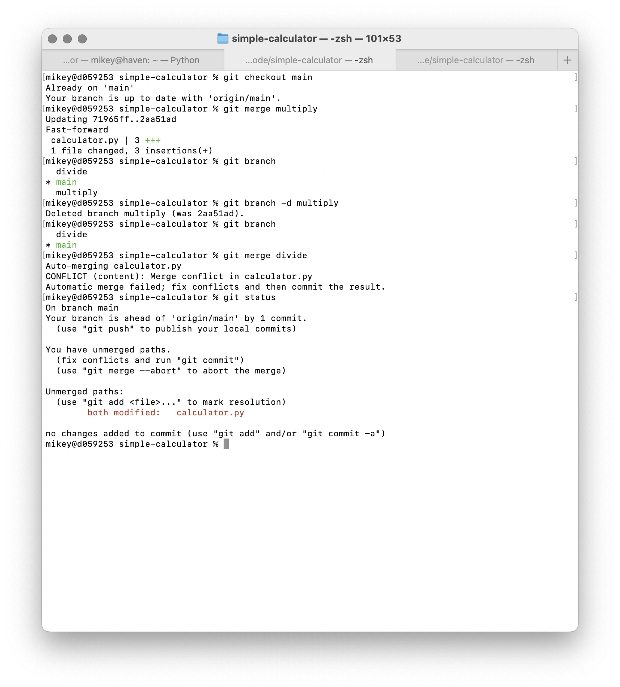
Handling Merge Conflicts
Git is very smart about how it merges changes from multiple branches together
If the branch you’re merging from doesn’t change any files that the branch you’re merging into has changed, such as when you merged “multiply” into “main”, git performs a simple fast-forward merge
Git will even automatically merge branches where different parts of the same file (at least a couple of lines apart) were changed on both branches
If, however, you changed the same part of the same file on both branches, you need to tell git how to merge the two together manually
This sounds scary, but it’s not that hard — if you run “git status” after encountering a merge conflict, git will tell you what to do

Slide 26
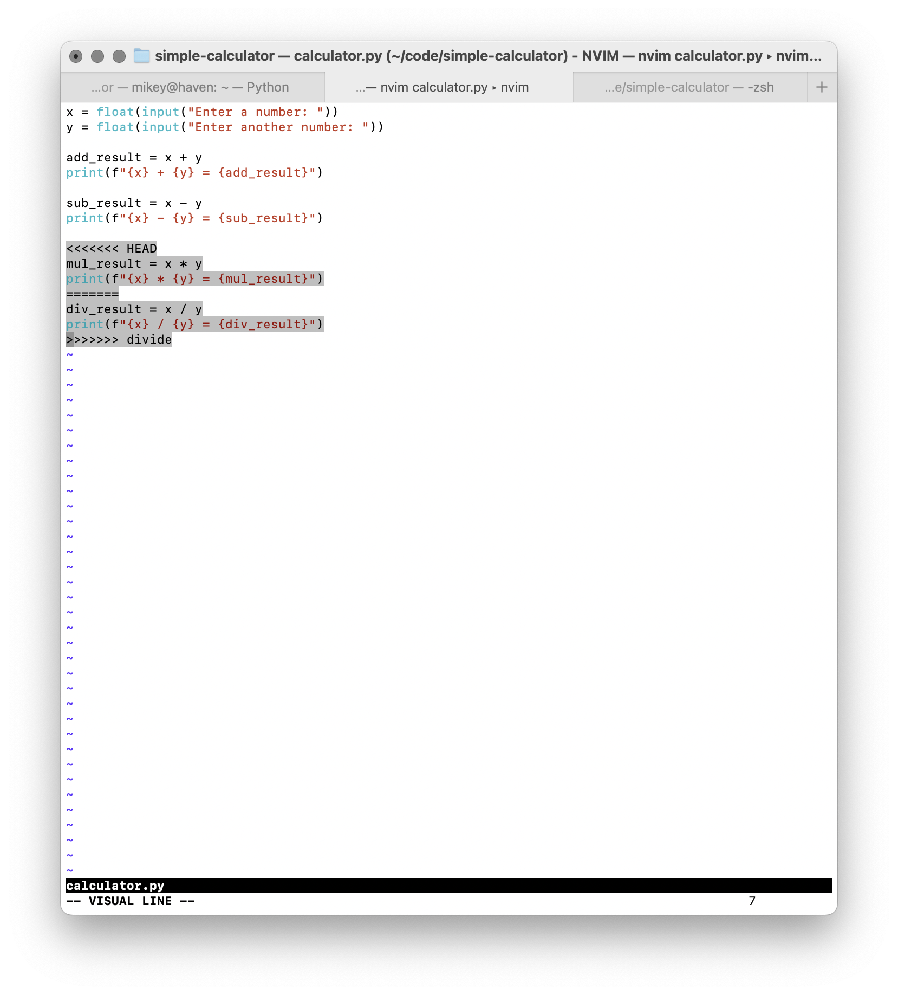
Handling Merge Conflicts
If you look at your code, you’ll see git has included both versions of the changes you made, as well as some markers so you can identify which is which
Remember that “HEAD” is currently pointing at “main”, so the top section contains the changes made on “main” (which were merged from the “multiply” branch)
The bottom section contains the changes made from the “divide” branch
The sections are separated by a row of “=“ characters
All you have to do is manually fix the code (in this case we’d like to keep both sections
Make sure you remove the section dividers git has added, they’ll cause a syntax error otherwise
Once you’ve fix the code “git add” and “git commit” it, and git will finish merging the branches!

Slide 27
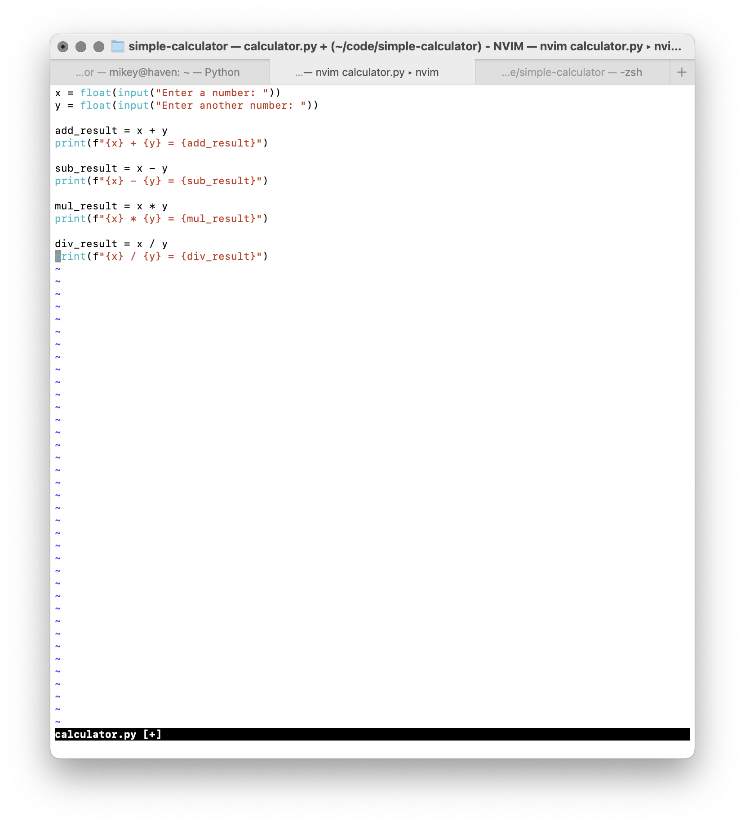
Handling Merge Conflicts
If you look at your code, you’ll see git has included both versions of the changes you made, as well as some markers so you can identify which is which
Remember that “HEAD” is currently pointing at “main”, so the top section contains the changes made on “main” (which were merged from the “multiply” branch)
The bottom section contains the changes made from the “divide” branch
The sections are separated by a row of “=“ characters
All you have to do is manually fix the code (in this case we’d like to keep both sections
Make sure you remove the section dividers git has added, they’ll cause a syntax error otherwise
Once you’ve fix the code “git add” and “git commit” it, and git will finish merging the branches!

Slide 28
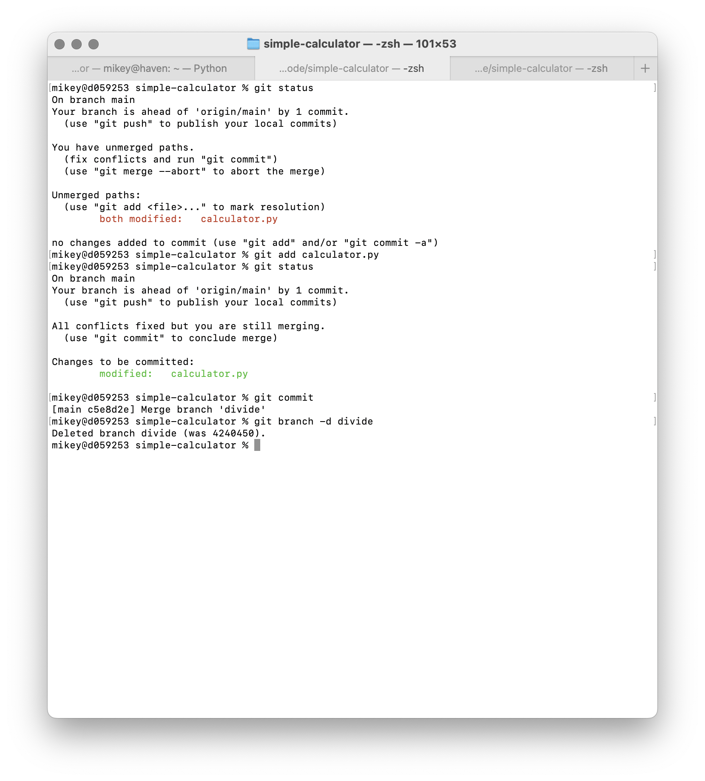
Handling Merge Conflicts
If you look at your code, you’ll see git has included both versions of the changes you made, as well as some markers so you can identify which is which
Remember that “HEAD” is currently pointing at “main”, so the top section contains the changes made on “main” (which were merged from the “multiply” branch)
The bottom section contains the changes made from the “divide” branch
The sections are separated by a row of “=“ characters
All you have to do is manually fix the code (in this case we’d like to keep both sections
Make sure you remove the section dividers git has added, they’ll cause a syntax error otherwise
Once you’ve fix the code “git add” and “git commit” it, and git will finish merging the branches!

Slide 29
The Github Pull Request Workflow
So far we’ve developed our own personal project in isolation. But what about when you want to have several people collaborate on a single project
This is where Github shines, as a tool for providing a central place from which to distribute your code to the members of your team, and accept contributions
When you want to contribute to a project on Github, you:
Fork the repository, creating a copy of it on your Github account
Clone your copy of the repository
Make, commit and push your changes
Open a pull request back to the original repository

Slide 30
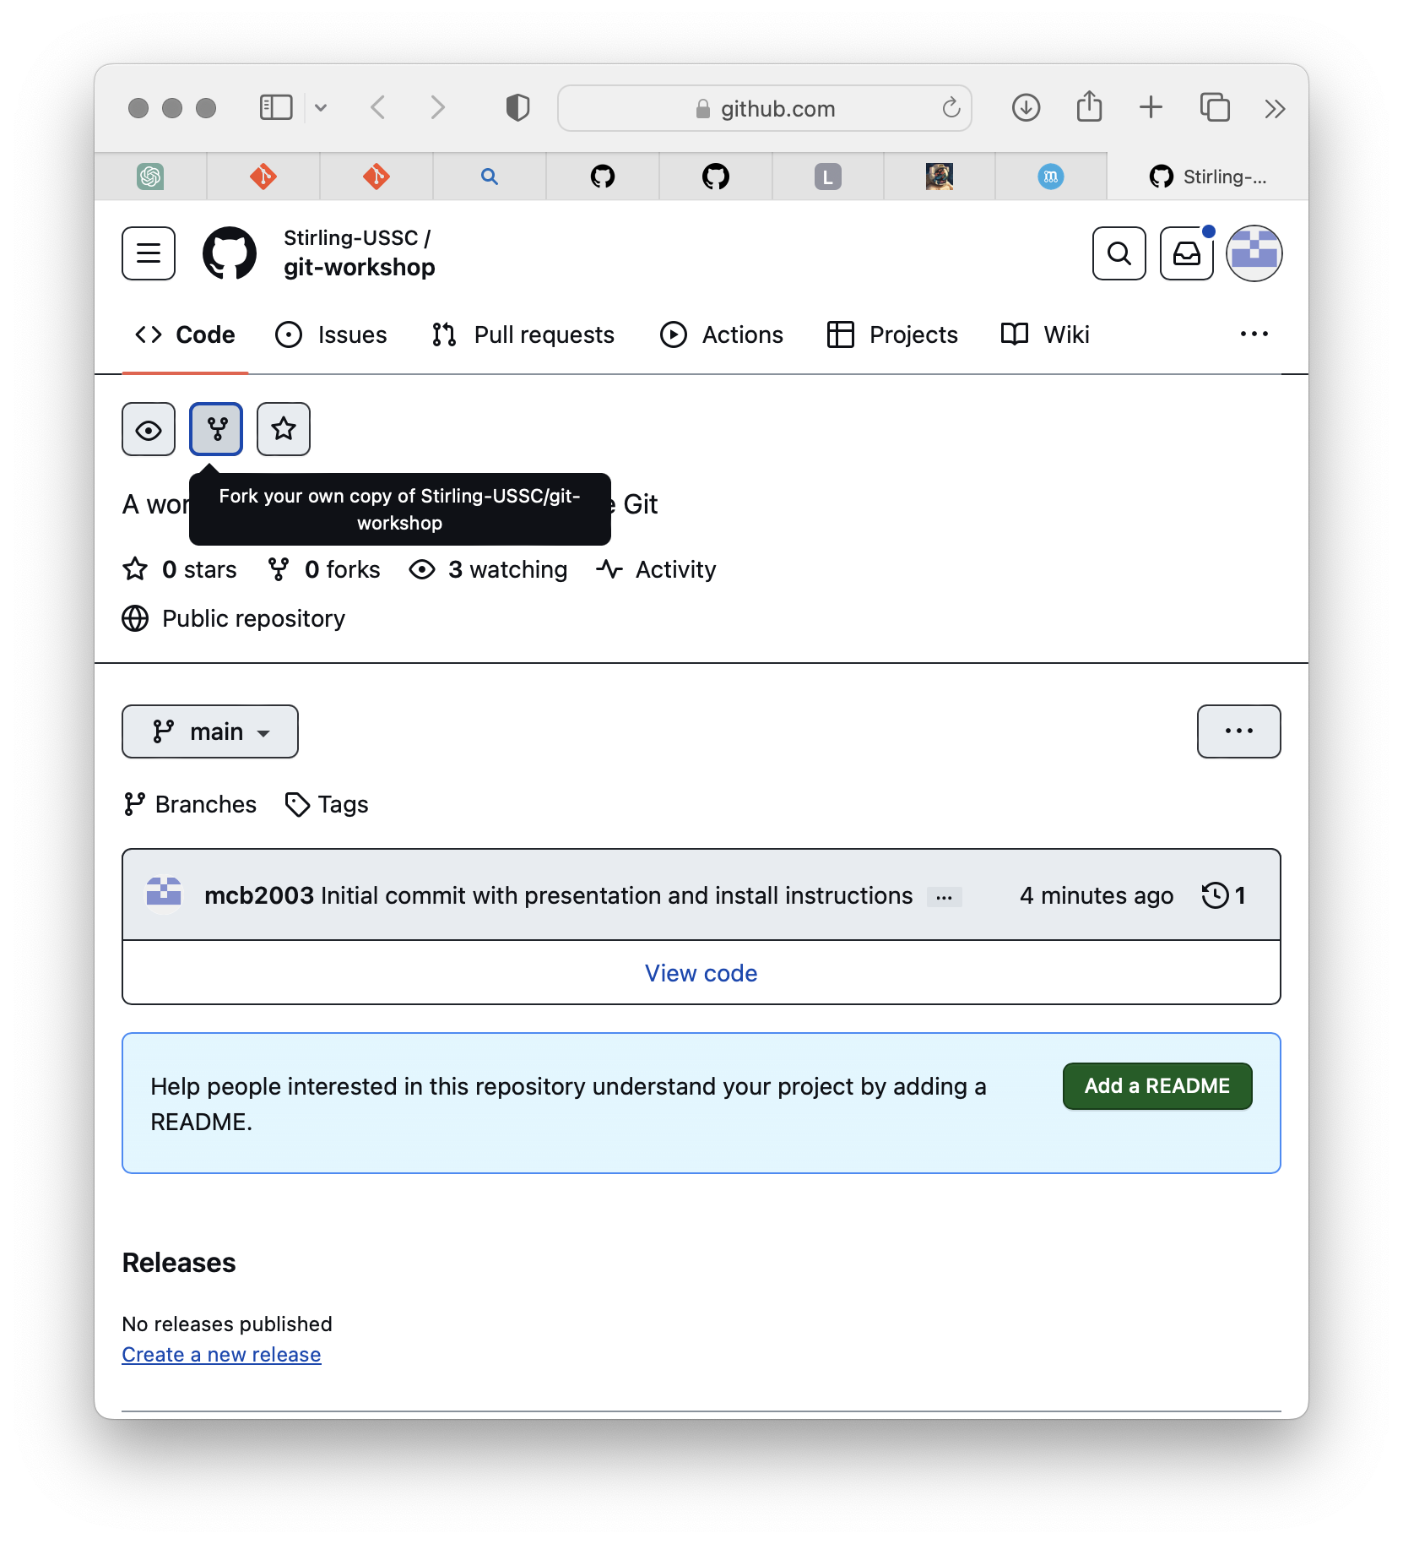
Making a Pull Request
We love hearing your feedback and suggestions, so we’ve created a repository which you can add them to!
First, go to https://github.com/stirling-ussc/git-workshop
Make sure you’re signed in, then click the “fork” button

Slide 31
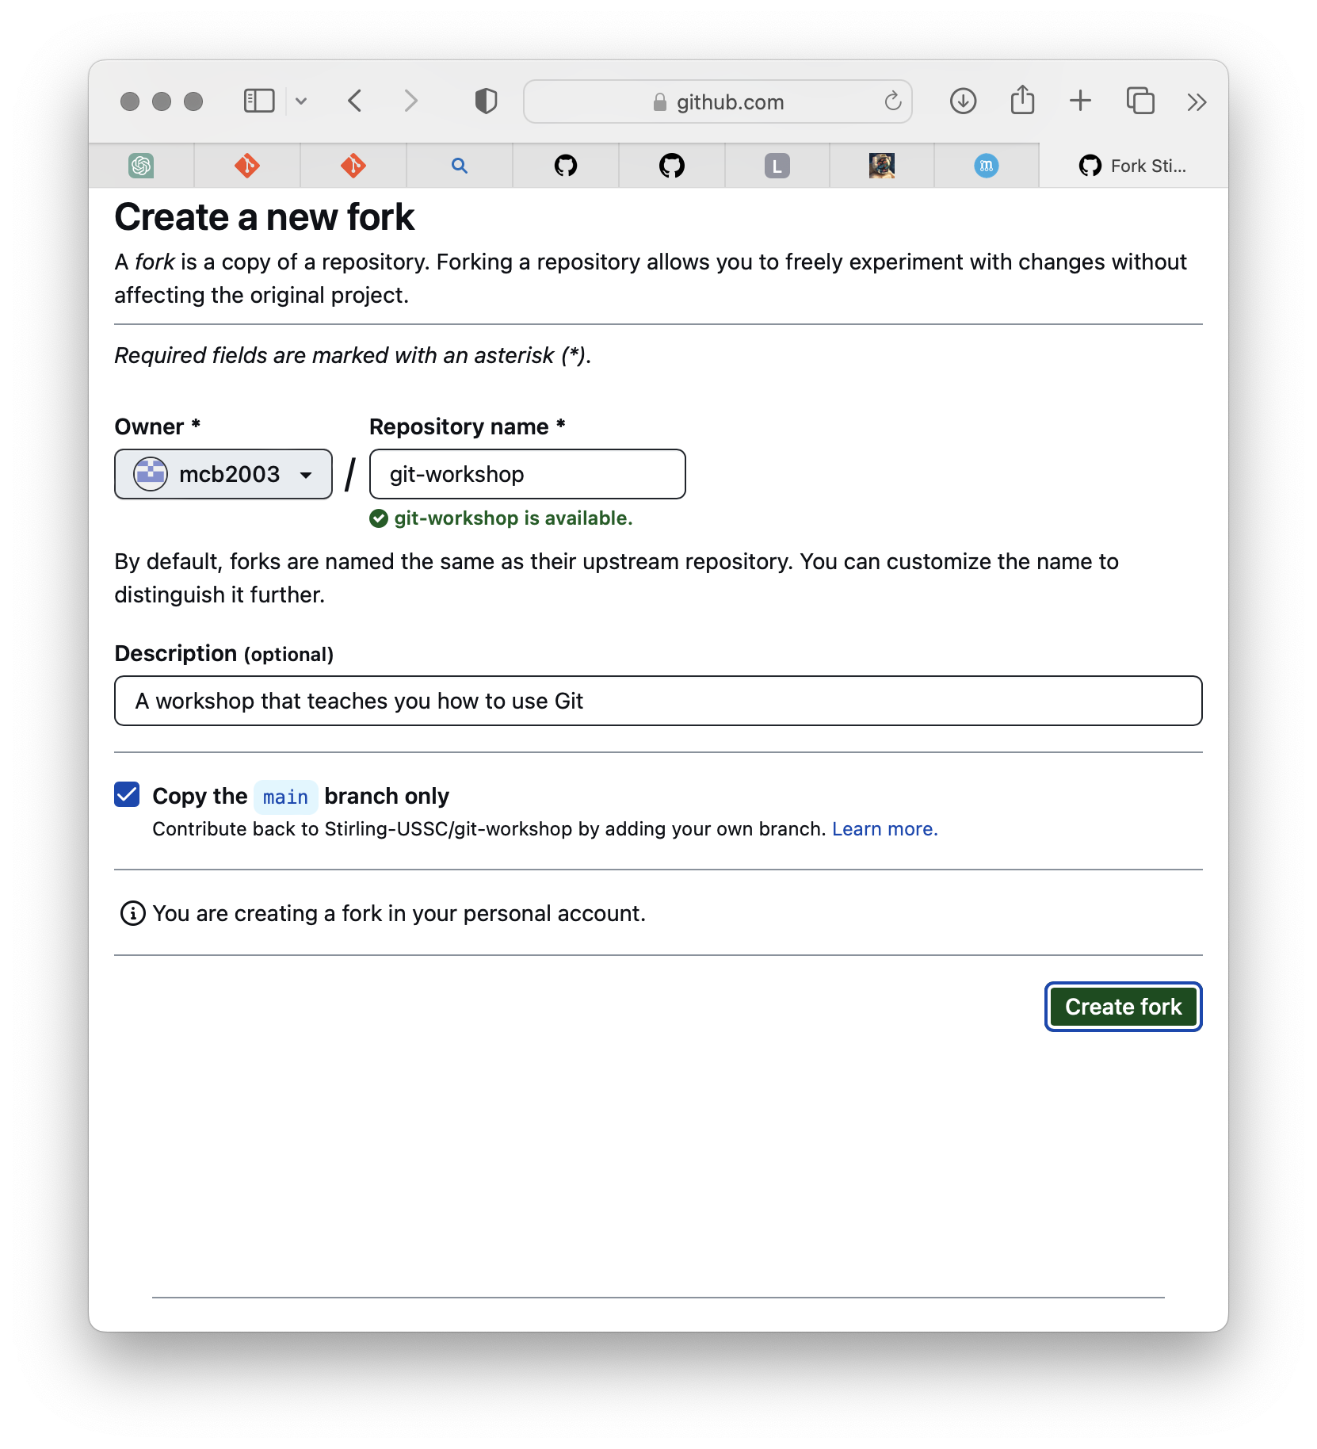
Making a Pull Request
We love hearing your feedback and suggestions, so we’ve created a repository which you can add them to!
First, go to https://github.com/stirling-ussc/git-workshop
Make sure you’re signed in, then click the “fork” button
Ensure that the fork will be created on your main Github profile (@mcb2003 in my case), then click “Create Fork”

Slide 32
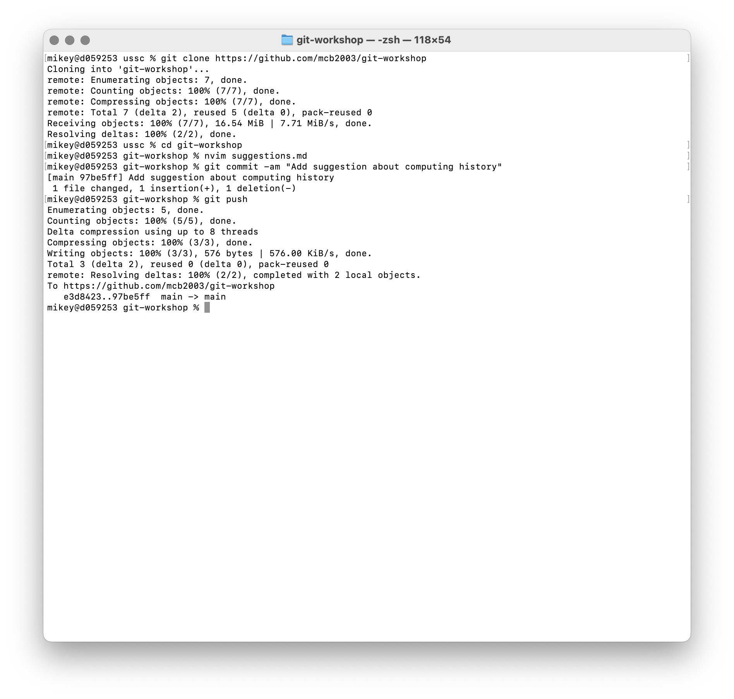
Making a Pull Request
We love hearing your feedback and suggestions, so we’ve created a repository which you can add them to!
First, go to https://github.com/stirling-ussc/git-workshop
Make sure you’re signed in, then click the “fork” button
Ensure that the fork will be created on your main Github profile (@mcb2003 in my case), then click “Create Fork”
Next, clone your version of the repository locally, make, stage and commit your changes, and push your changes to your fork of the repository
Replace “mcb2003” in the URL shown with your Github username

Slide 33
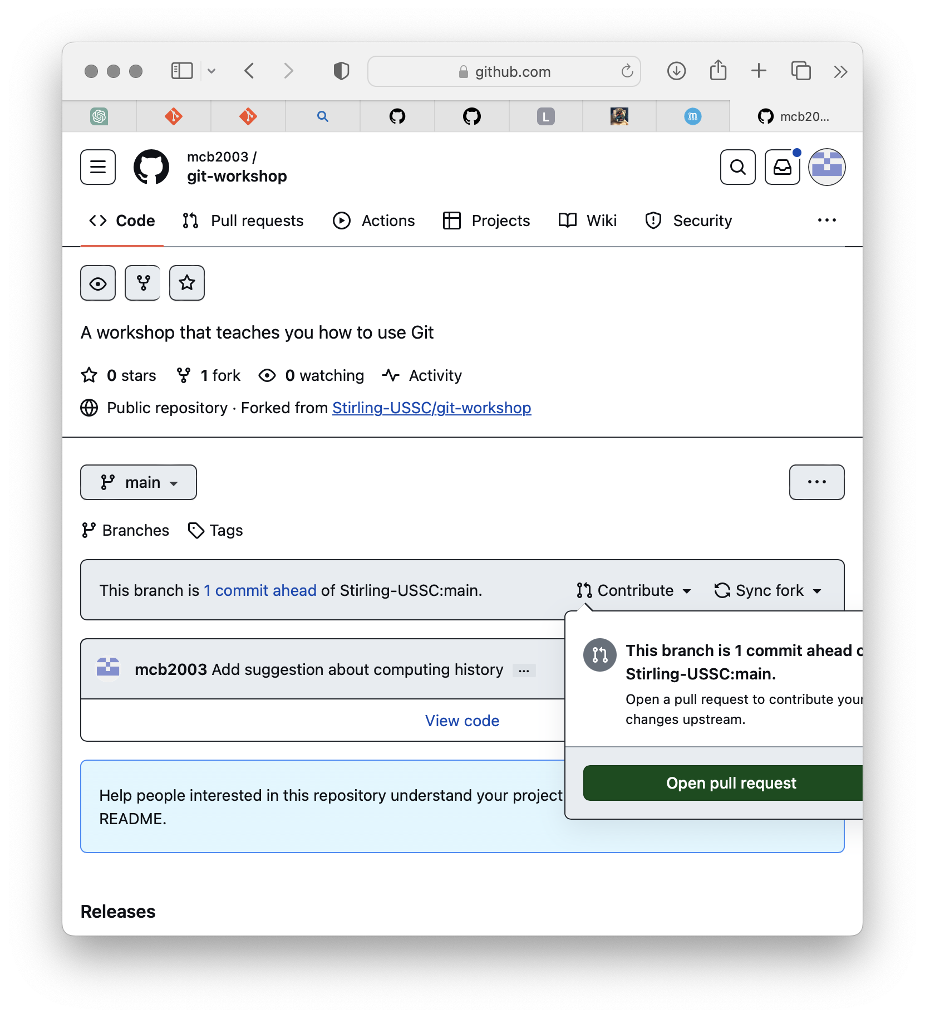
Making a Pull Request
We love hearing your feedback and suggestions, so we’ve created a repository which you can add them to!
First, go to https://github.com/stirling-ussc/git-workshop
Make sure you’re signed in, then click the “fork” button
Ensure that the fork will be created on your main Github profile (@mcb2003 in my case), then click “Create Fork”
Next, clone your version of the repository locally, make, stage and commit your changes, and push your changes to your fork of the repository
Replace “mcb2003” in the URL shown with your Github username
Next, go back to your fork on Github, and click “Contribute” then “Create Pull Request”

Slide 34
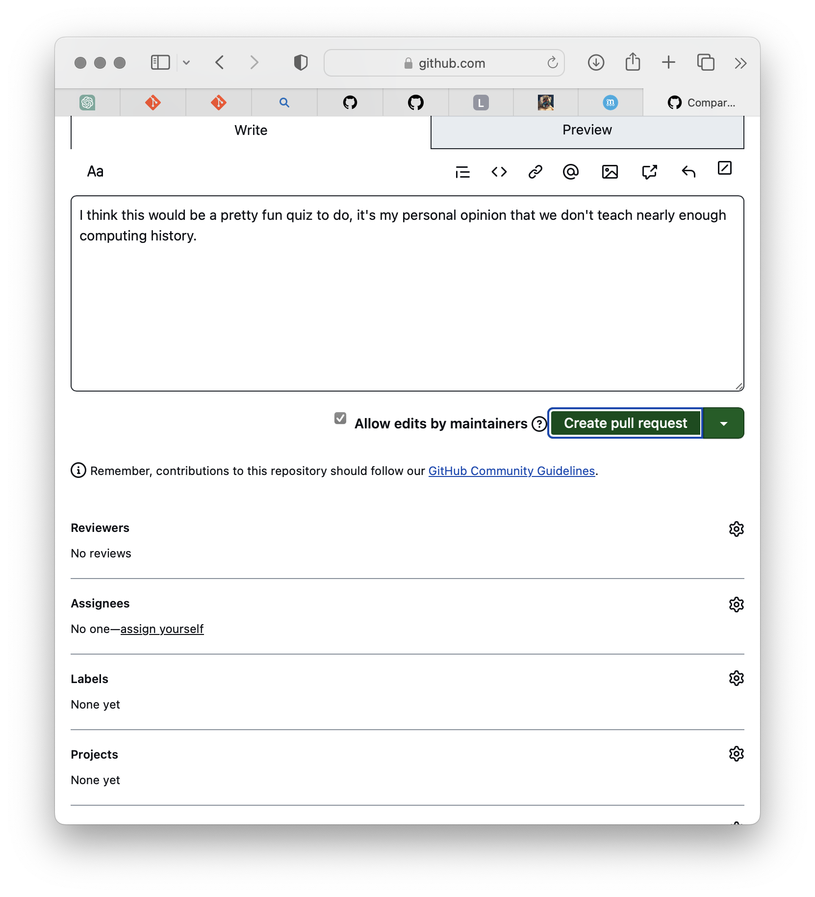
Making a Pull Request
We love hearing your feedback and suggestions, so we’ve created a repository which you can add them to!
First, go to https://github.com/stirling-ussc/git-workshop
Make sure you’re signed in, then click the “fork” button
Ensure that the fork will be created on your main Github profile (@mcb2003 in my case), then click “Create Fork”
Next, clone your version of the repository locally, make, stage and commit your changes, and push your changes to your fork of the repository
Replace “mcb2003” in the URL shown with your Github username
Next, go back to your fork on Github, and click “Contribute” then “Create Pull Request”
Give your PR a title, and explain what it’s for in the description, then click “Create Pull Request”

Slide 35
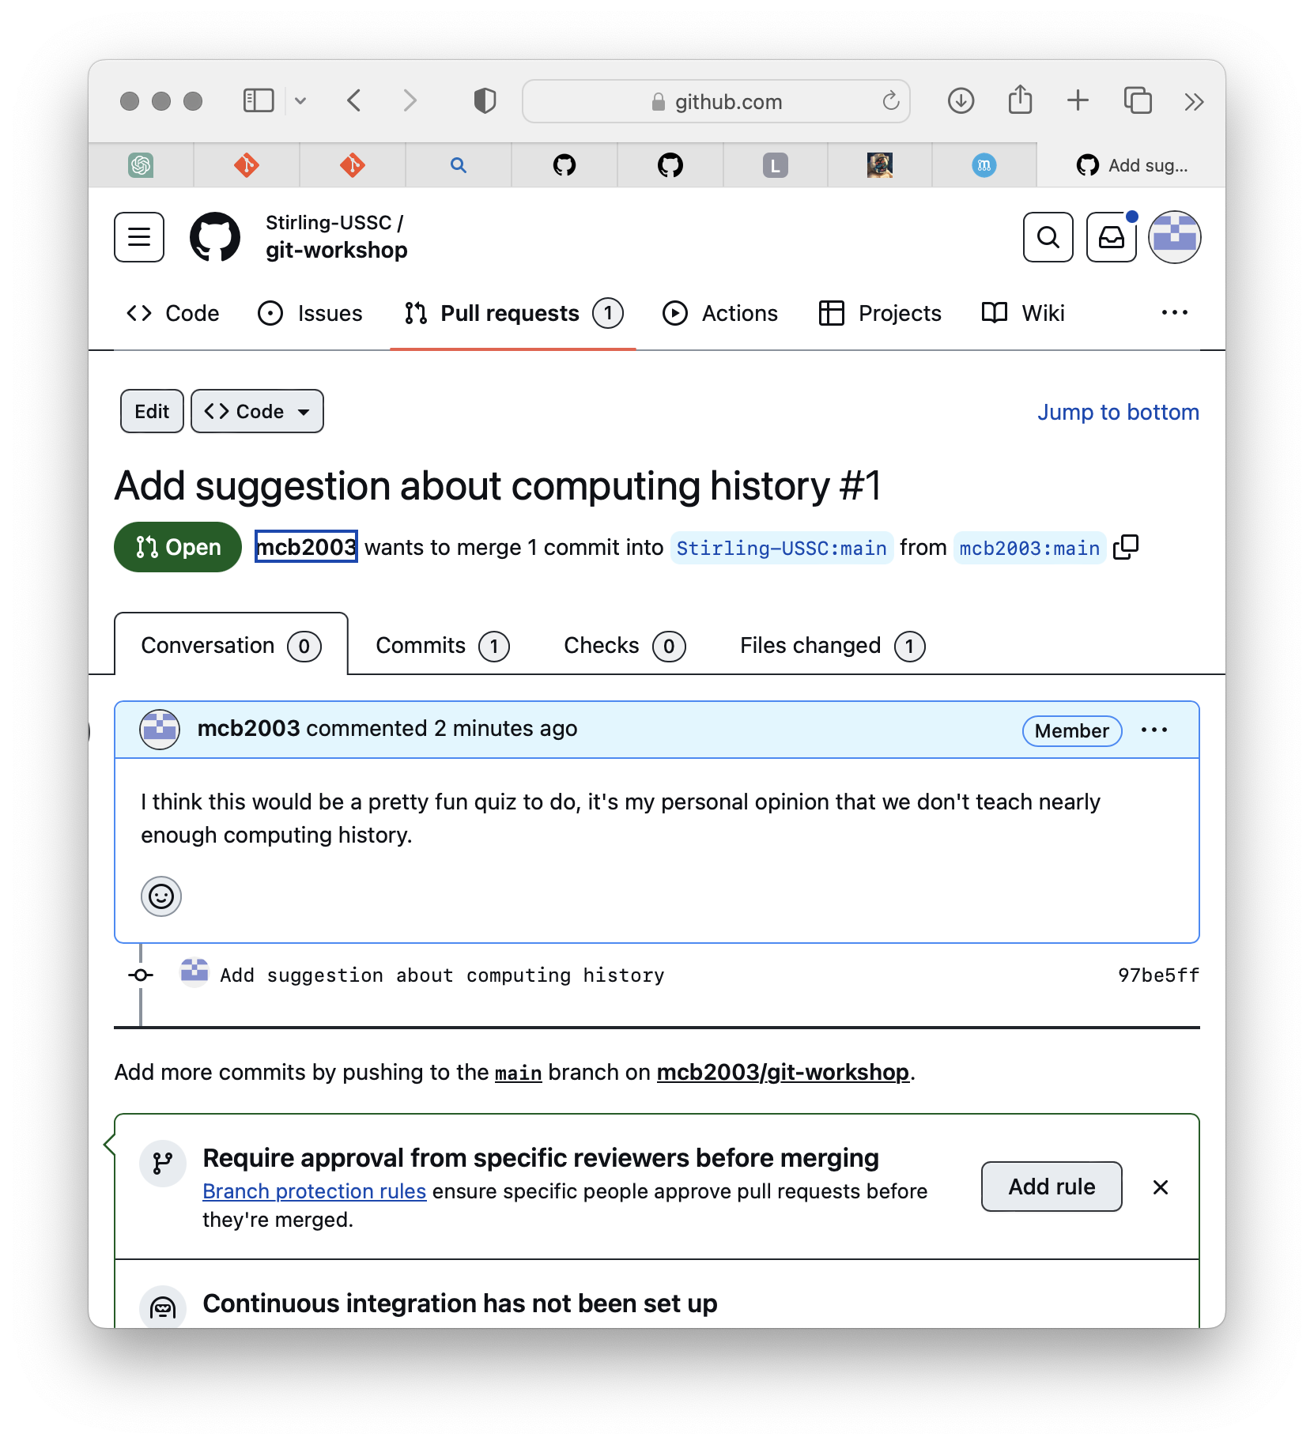
Making a Pull Request
We love hearing your feedback and suggestions, so we’ve created a repository which you can add them to!
First, go to https://github.com/stirling-ussc/git-workshop
Make sure you’re signed in, then click the “fork” button
Ensure that the fork will be created on your main Github profile (@mcb2003 in my case), then click “Create Fork”
Next, clone your version of the repository locally, make, stage and commit your changes, and push your changes to your fork of the repository
Replace “mcb2003” in the URL shown with your Github username
Next, go back to your fork on Github, and click “Contribute” then “Create Pull Request”
Give your PR a title, and explain what it’s for in the description, then click “Create Pull Request”
That’s it! You’ve successfully open a PR, and the maintainers of the project (the USSC committee in this case) can now comment on your suggestion via the PR comments thread, and merge or close your request!

